Slide 1

BE THE GREEN SOLUTION
https://youtu.be/_CIPLOajR58

Slide 2

Planet Green Force Embraces UNESCO
Education Programming
United Nations Educational, Scientific and Cultural Organization
UNESCO's programs contribute to the achievement of the Sustainable Development Goals defined in the 2030 Agenda, adopted by the UN General Assembly in 2015. They include:
UNESCO Greening Education Partnership
Multi-pronged approach including greening schools, greening education, greening teacher training and education system’s capacities, and greening communities.
Climate Science Literacy
Ensuring the next generation is climate science literate & understands how it must inform our way of life in order to protect it.

Slide 3


Planet Green Force
Sustainability League for Youth
Harith Wickrema, Founder

Slide 4
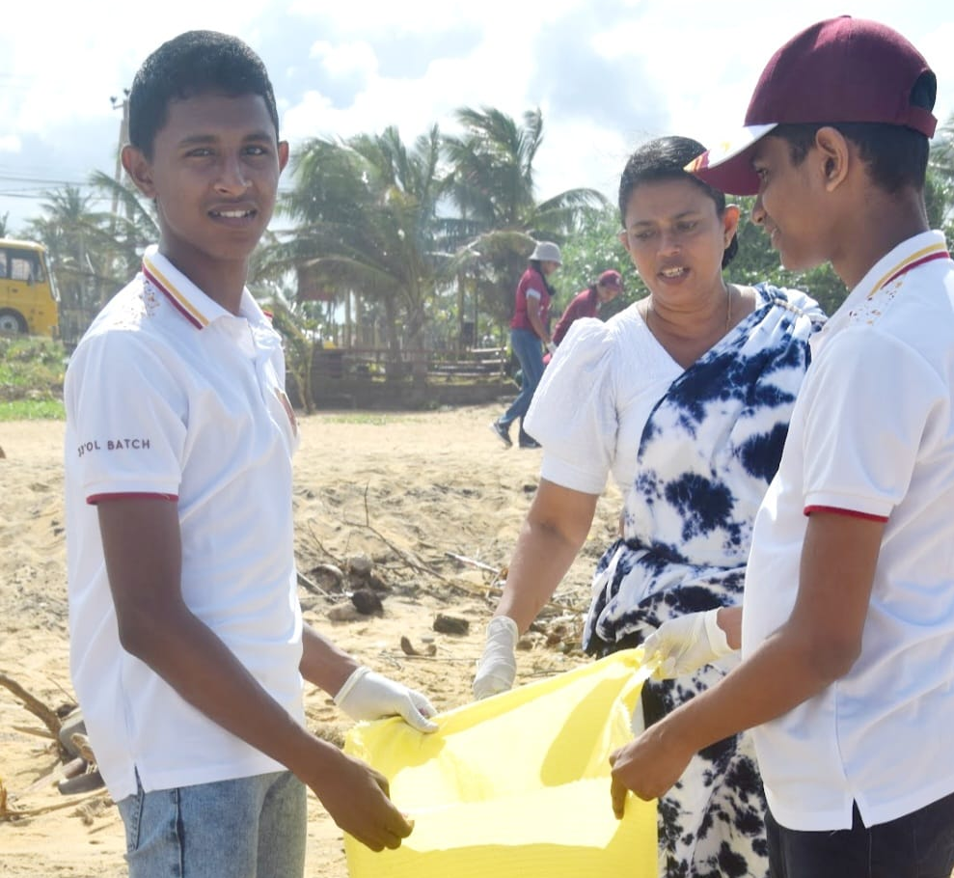
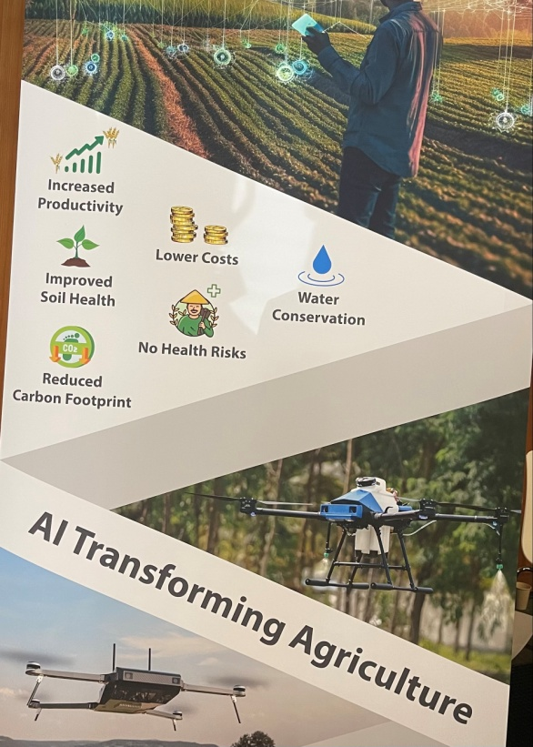
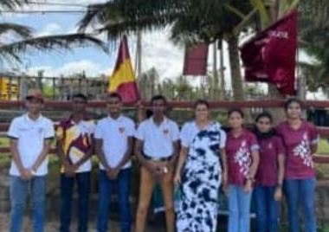

Planet Green Force Mission
In collaboration with UNESCO, Planet Green Force (PGF) is envisioned as a worldwide league for youth K-12 with the mission to educate, engage, ignite passion, build awareness and mount meaningful change in eradicating hunger, battling global warming, embracing green initiatives & fighting for environmental justice.
Inspire the next generation of Green LEADERS!

Slide 5
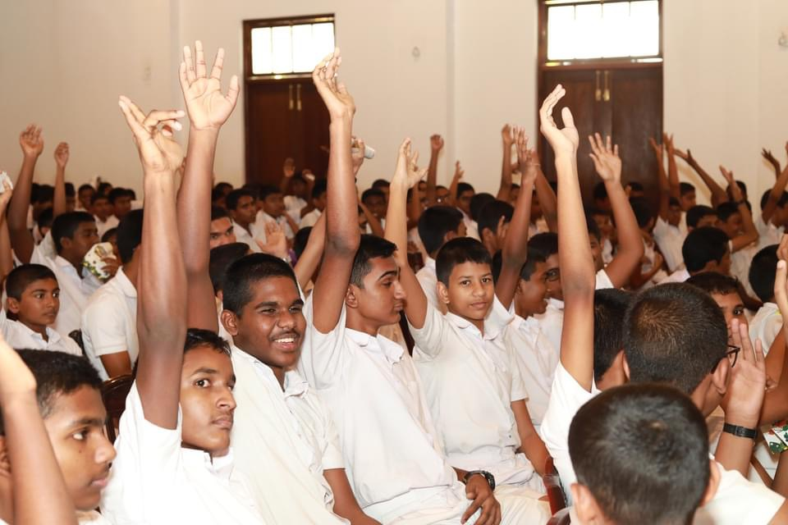
School Pride: Ananda College Makes History as
Very First Planet Green Force Pilot!
Sets new standards in environmental education and food security programming with the partnership of
Planet Green Force, UNESCO & CIC Holdings PLC
Model to be Replicated Internationally

Slide 6

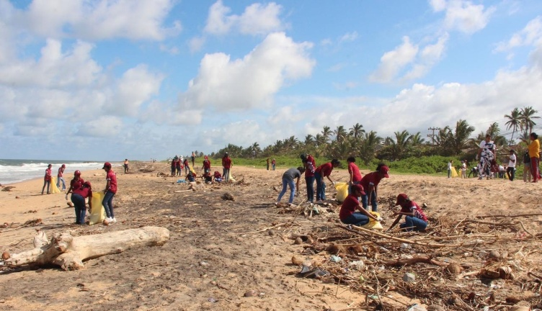
Key Elements of PGF
Experiential learning: age-appropriate environmental/agri concepts in core curriculum, engaging activities & project work
Embrace UN’s Sustainable Development Goals
Green Word of the Day
Guest speakers/field trips
Introduction to “AI for Good” technology & vital role of tech
Youth encouraged & rewarded for spreading what they learn: Green Advocacy

Slide 7
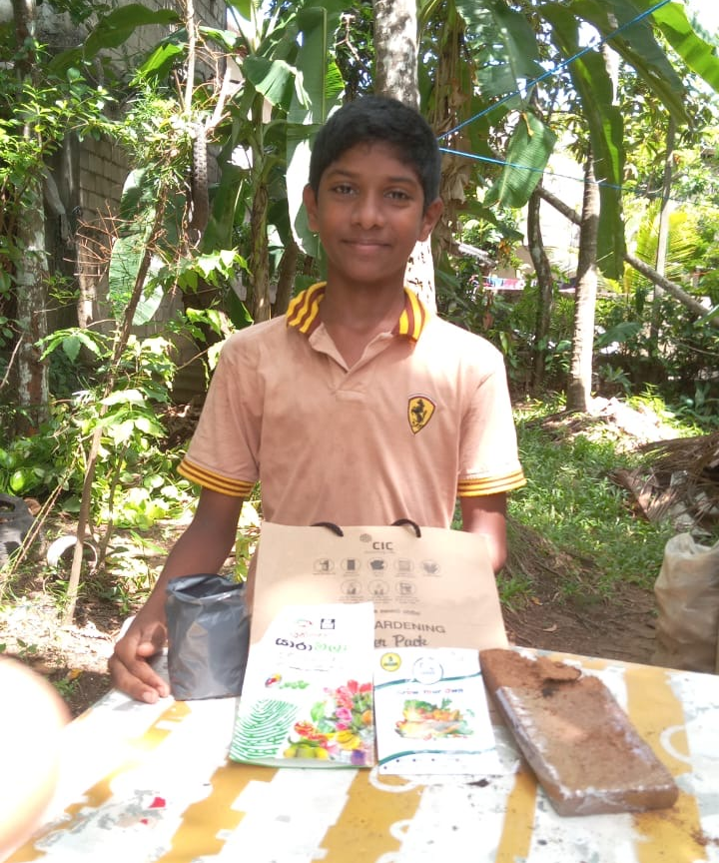
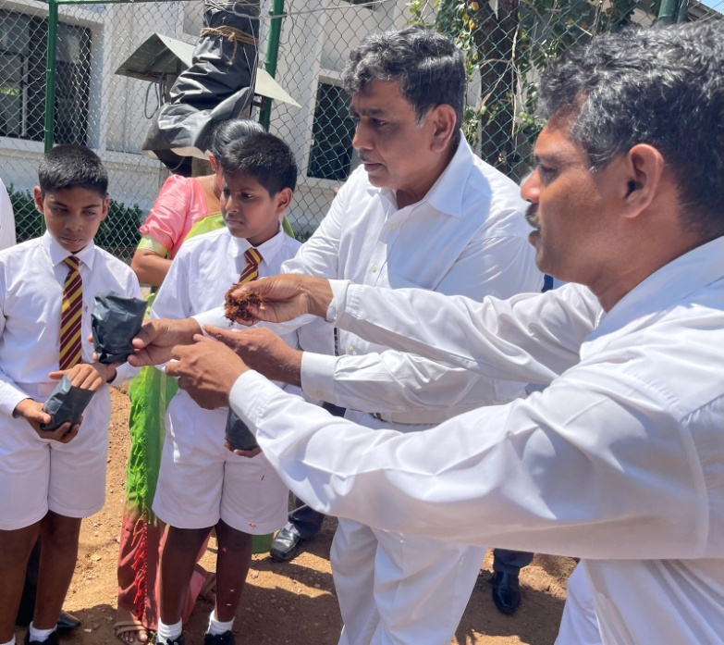
Key Elements of PGF
Regional competitions celebrate, share innovation, motivate
Promote creativity, power of teamwork/ collaboration; develop PGF pledge, song, etc.
Adopt UNESCO Climate Science Literacy as well as former Green Academies’ pillars:
  Water Security
  Waste Management
  Clean Energy
  Biomass Production
    Grow/Raise Food = Food Security
    Biofuel Production
Incorporate best practices, top green ed programs

Slide 8
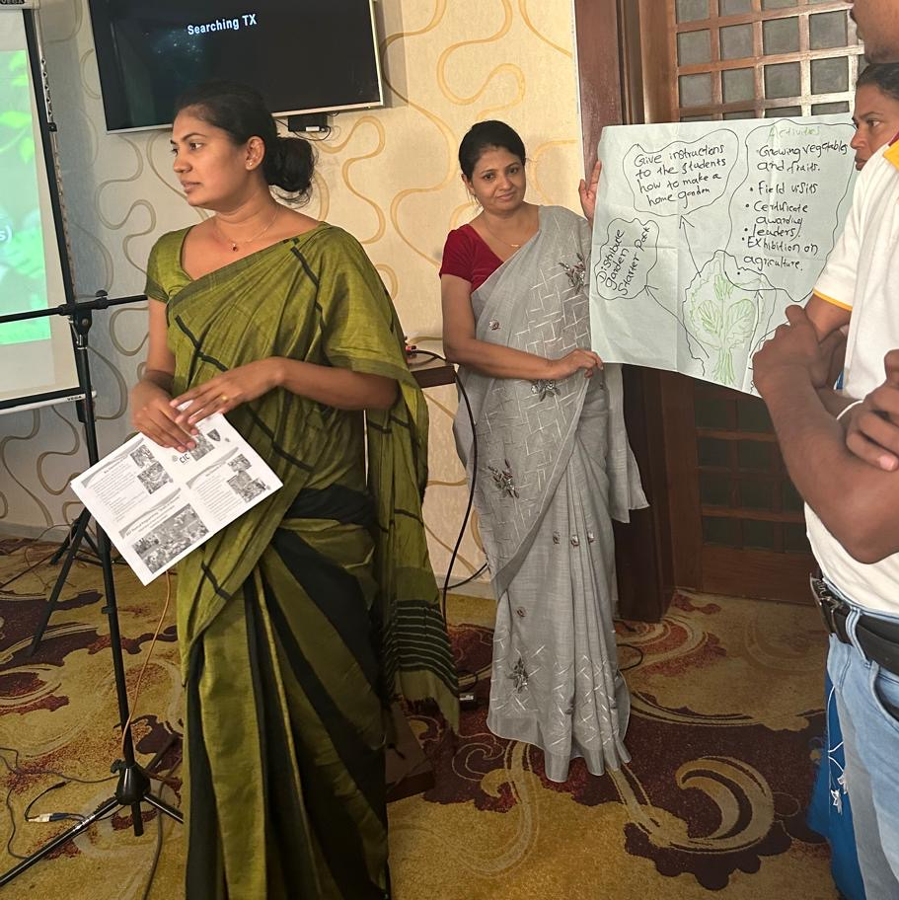
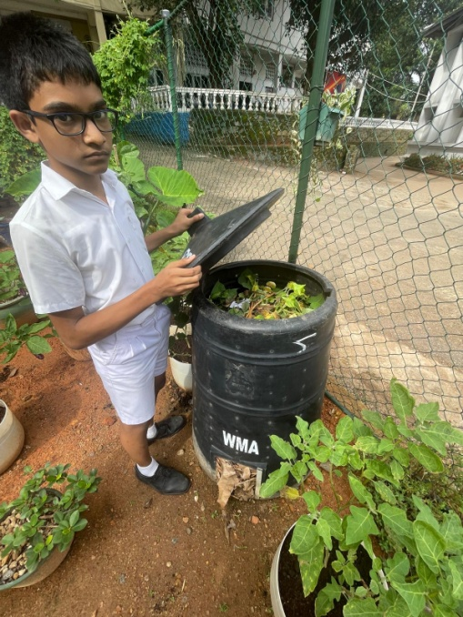
Embrace UNESCO Greening Education Partnership
Four Pillars
Greening Schools
Greening Education
Greening Teacher Training & Education System’s Capacities
Greening Communities

Slide 9

First Planet Green Force Center to Launch at Ananda College
Innovative eco-learning, teaching & research hub – a living laboratory
Incorporates latest sustainable construction including cradle-to-cradle/recycled materials, solar energy, rainwater harvesting, former Green Academies’ pillars
Green house, hydroponics, aquaponics, aeroponics, composting methods, testing & research on ecosystems/food science, test kitchen. LED screens showcase UN SDGs, Climate Science Literacy
Experiential hands-on learning embody the tenets of Planet Green Force

Slide 10
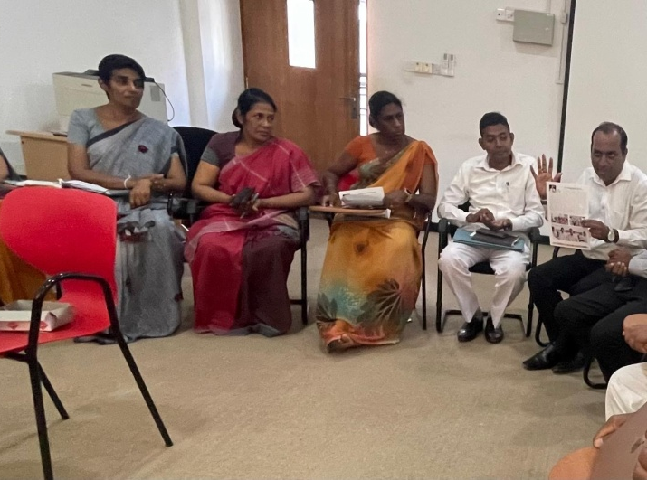
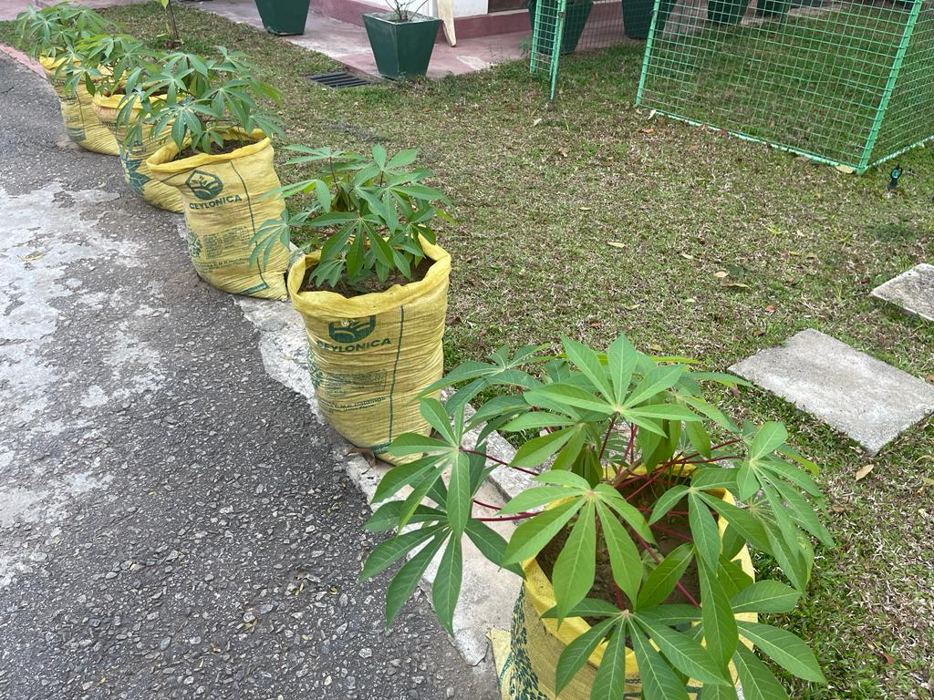
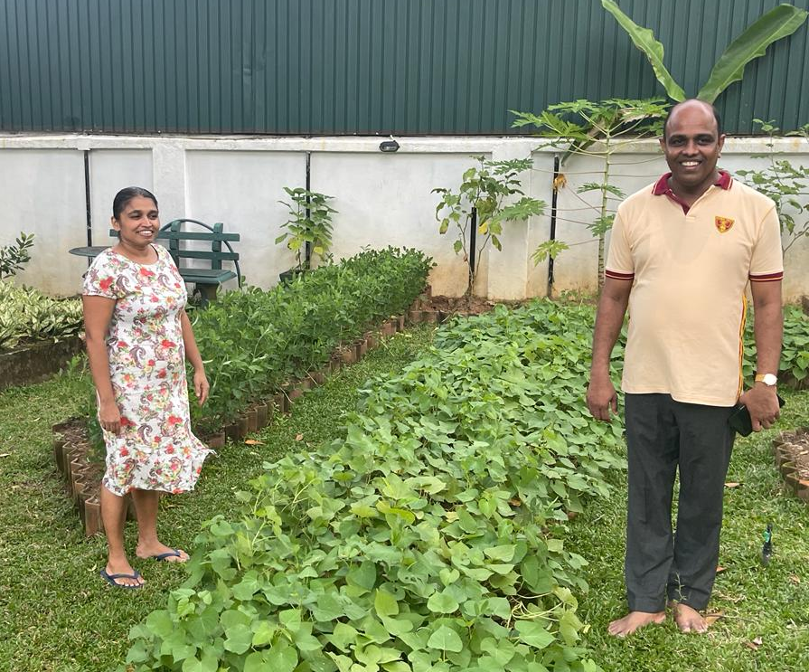
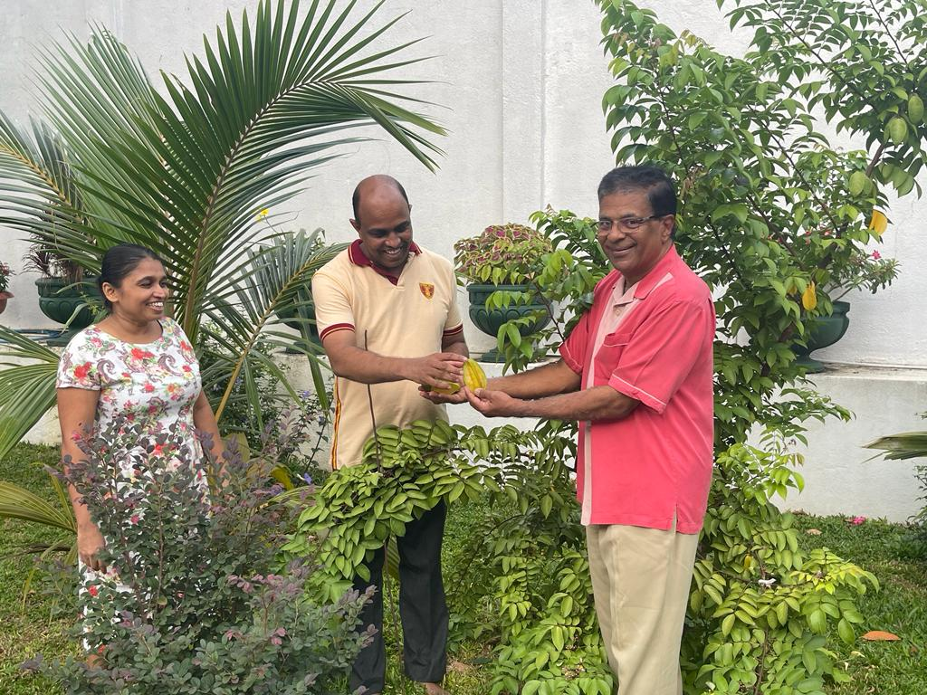
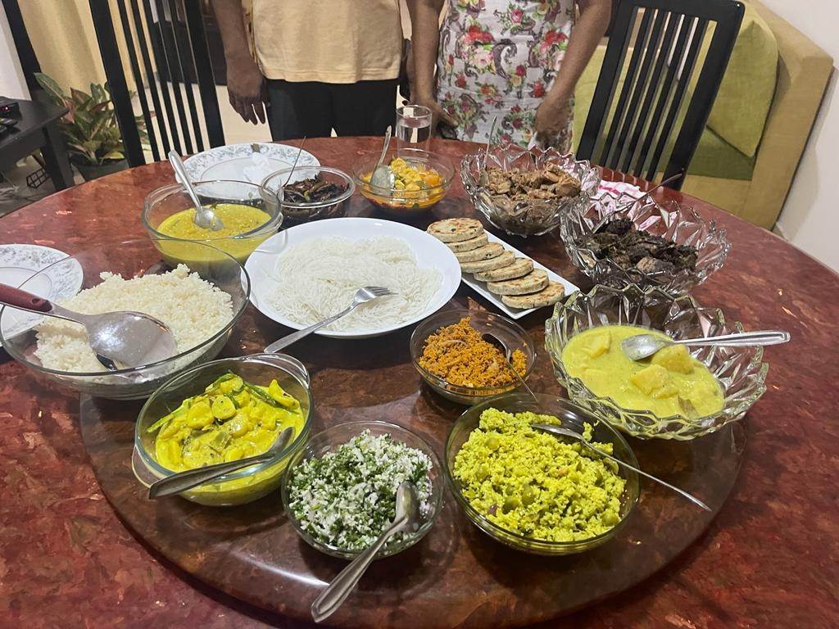
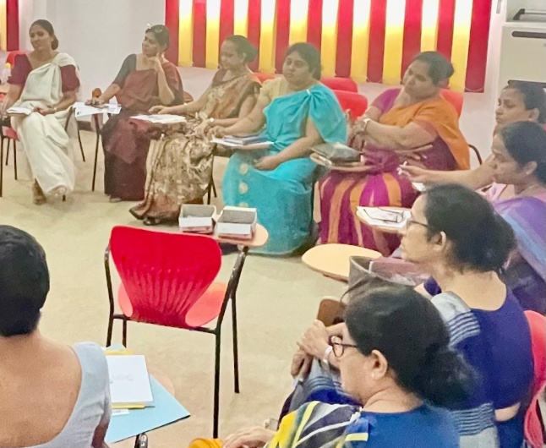
PGF Themed Programming: “Seeds of Security”
Importance of Food Security/Sovereignty
Model for Success

Slide 11
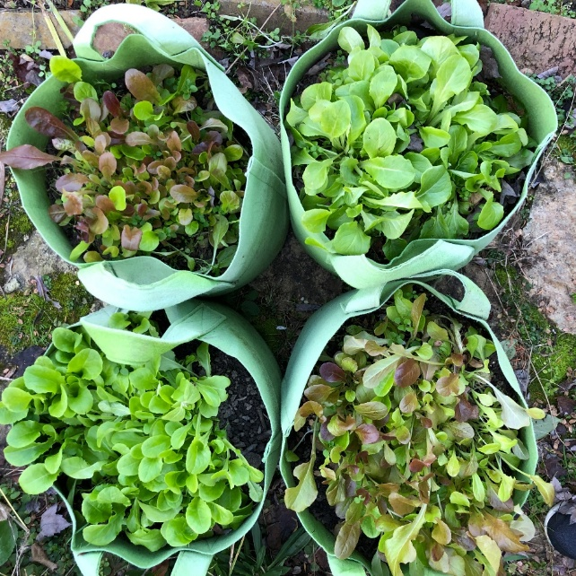

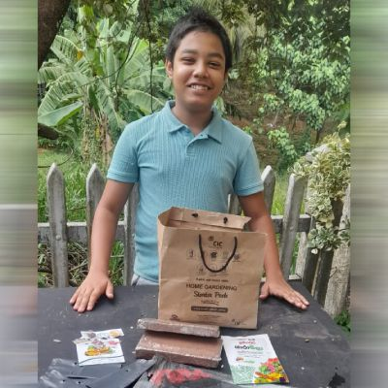
“Seeds of Security”
Grow container gardens: hands-on instruction
Provision of school hydroponics and/or aquaponics, work in school gardens
Intro to composting; start school compost pile/container
Help develop nutritious menu items incorporating “crops”
Sell excess through school marketplaces; help make program self-sufficient
Create opportunity similar to UN Food & Agriculture Organization’s “Global Chef Challenge” / Create cookbook
Field trips to farms, green markets, etc.

Slide 12
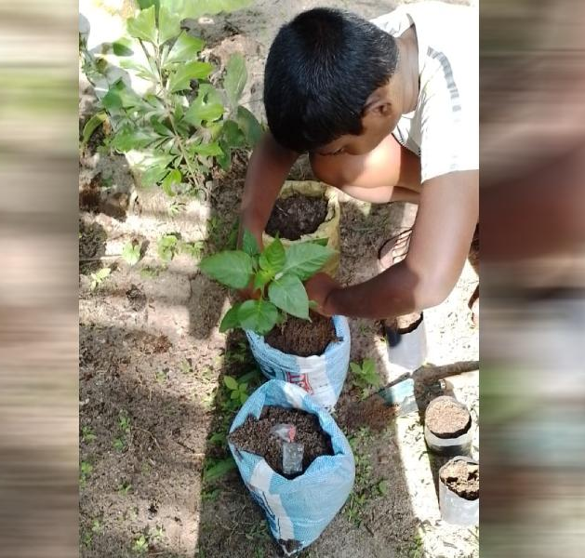
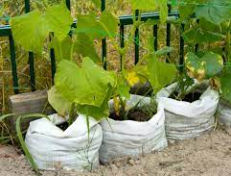
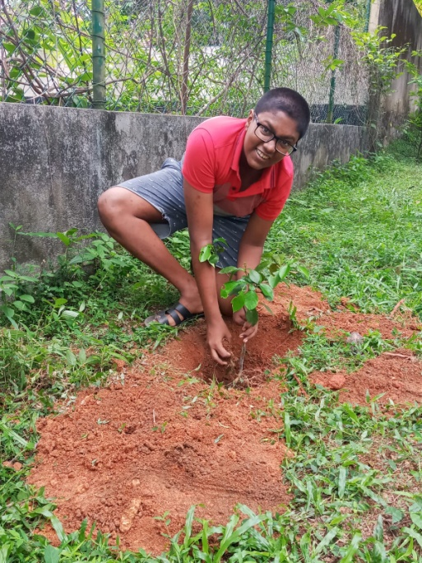
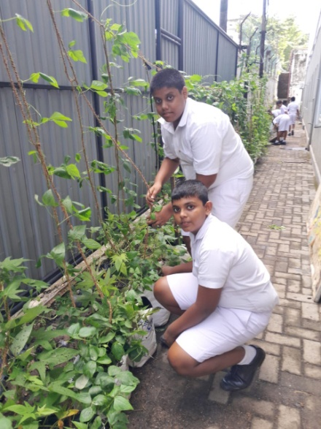
PGF Rollout Plan
Premiere Pilot Program: Ananda College, Sri Lanka
Three – Six USVI Schools as a Pilot Project
With data & success, expansion in Sri Lanka/South Asia
Simultaneous controlled expansion throughout USVI territory, then growth in U.S.
Firm up international partners by soliciting support from UNEP, UN, COP, FAO, etc.

Slide 13
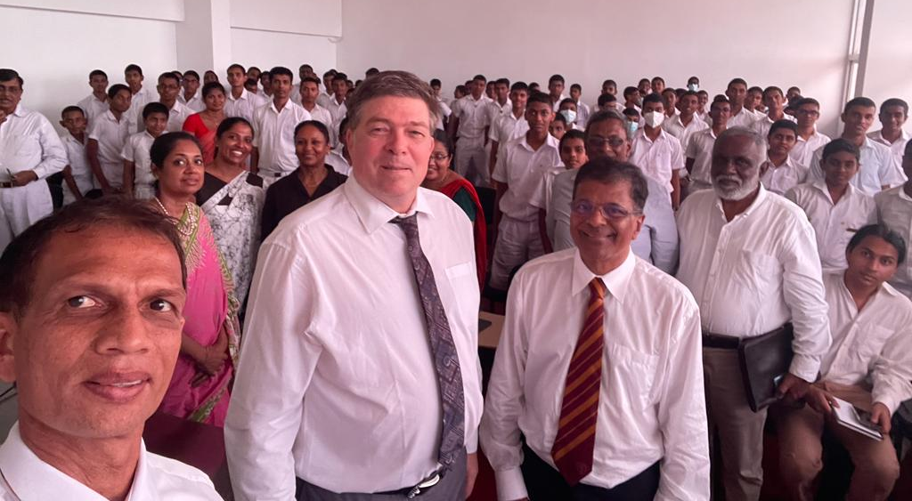
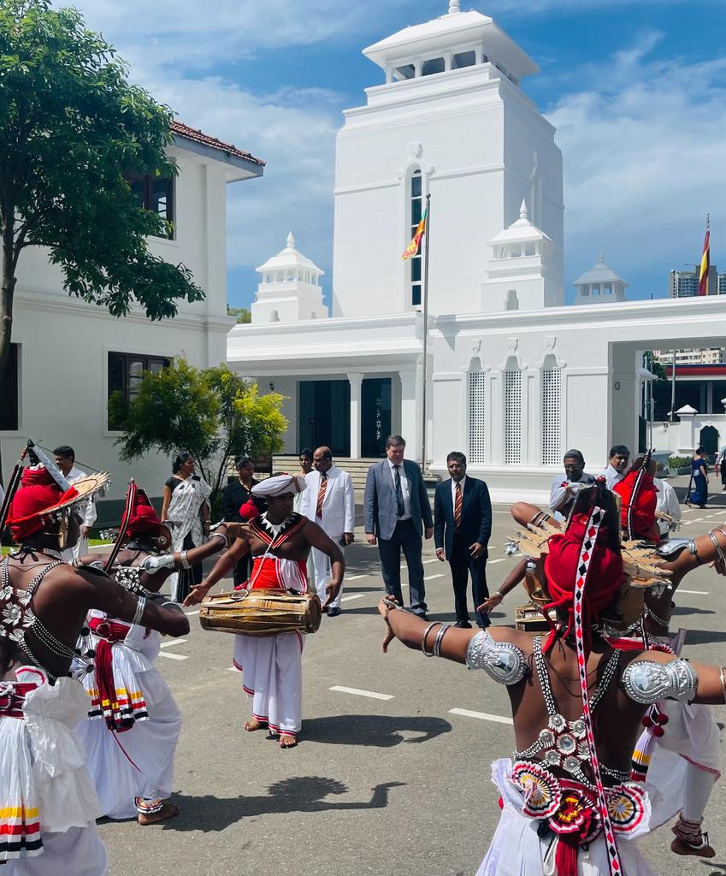
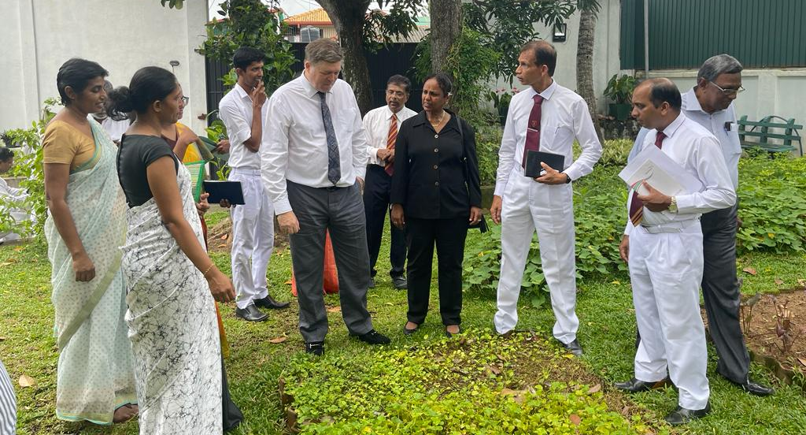
Birth of Planet Green Force at Ananda College
Theory into Practice

Slide 14
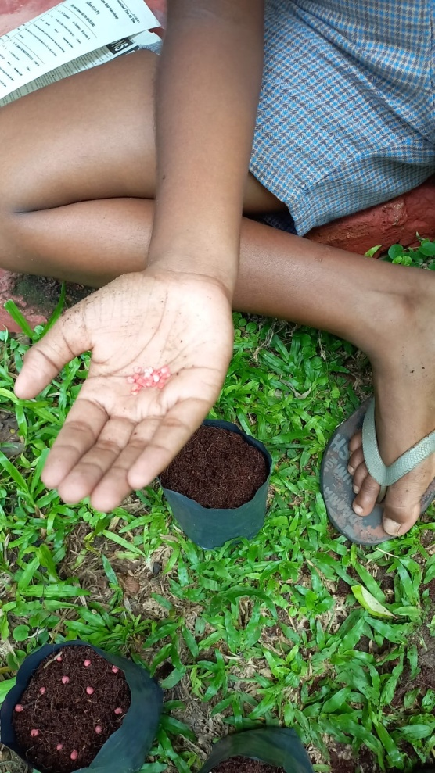
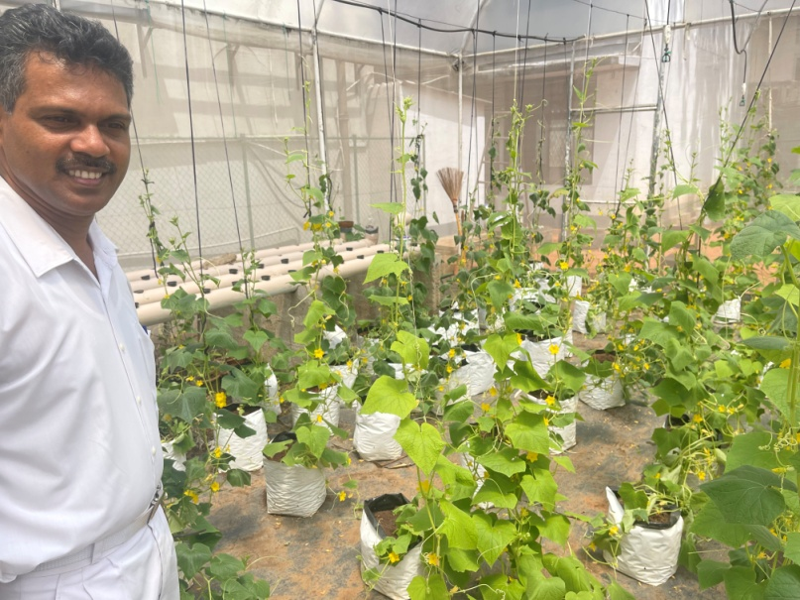
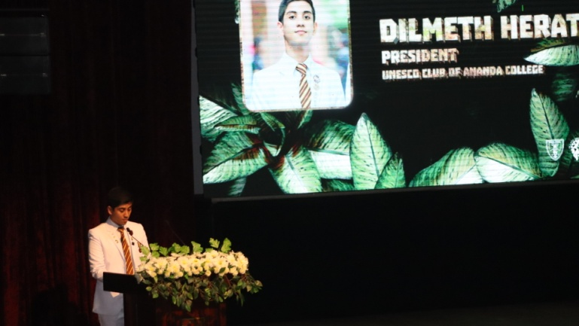
Ananda PGF Master Plan
Activity 1: Seeds of Security
Activity 2: Green Challenges
Activity 3: Green Educators
Activity 4: Green Academies Research Hub
Activity 5: Green Explorers
Activity 6: Eco Advocacy
Activity 7: Eco Voice
Activity 8: Green Melodies

Slide 15
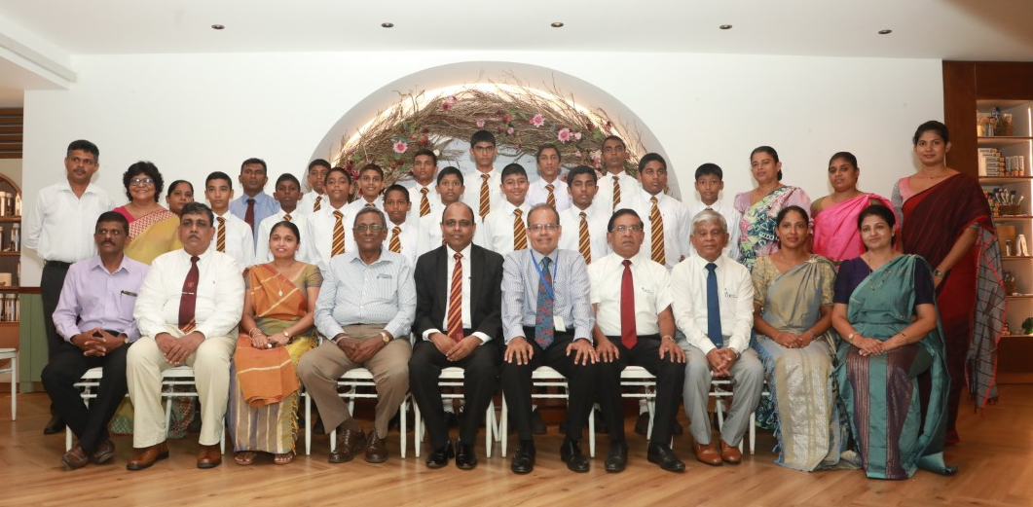
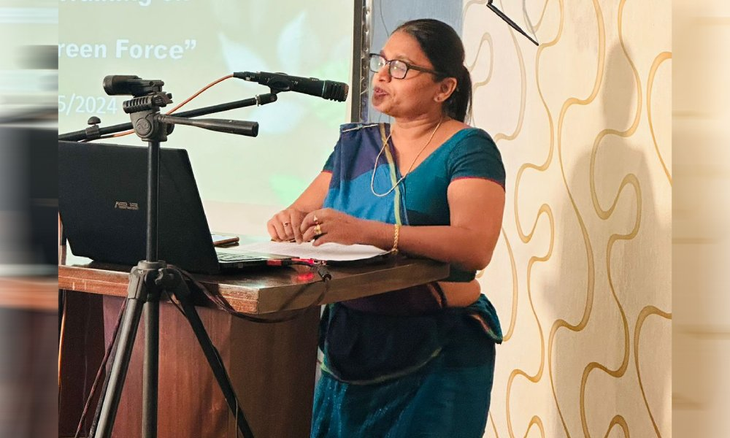
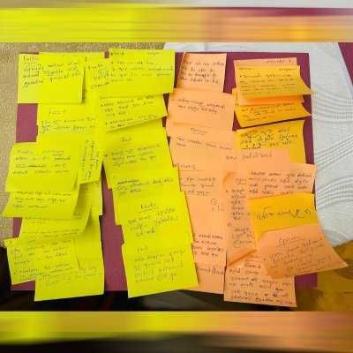
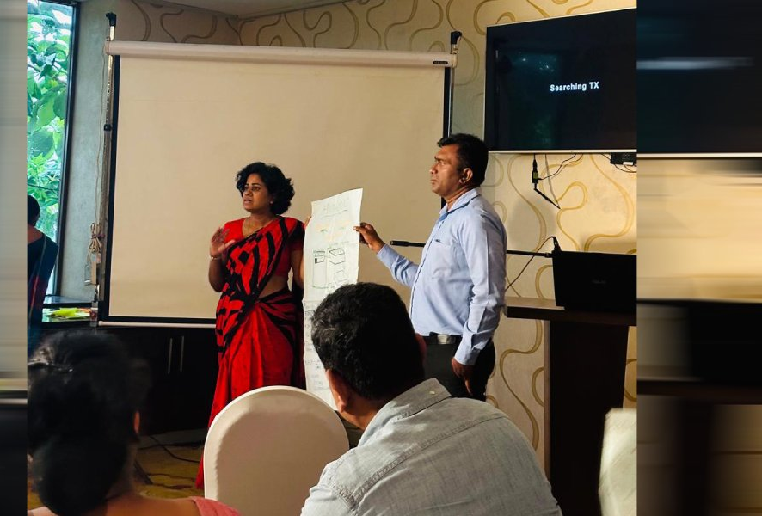
Teacher Trainings
Following the Pioneers

Slide 16
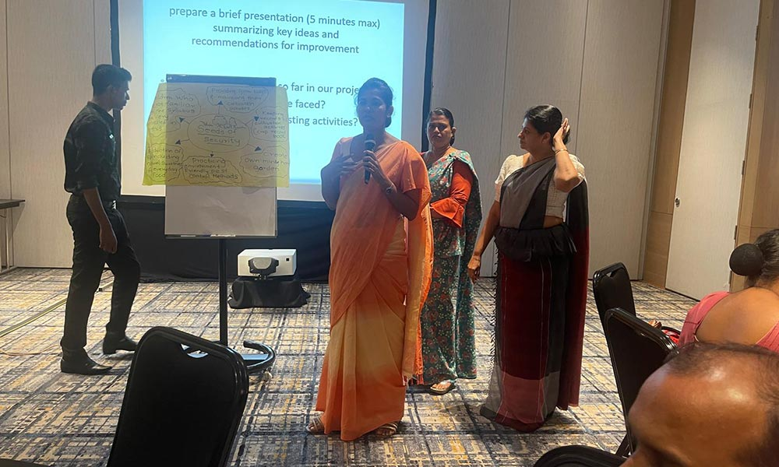
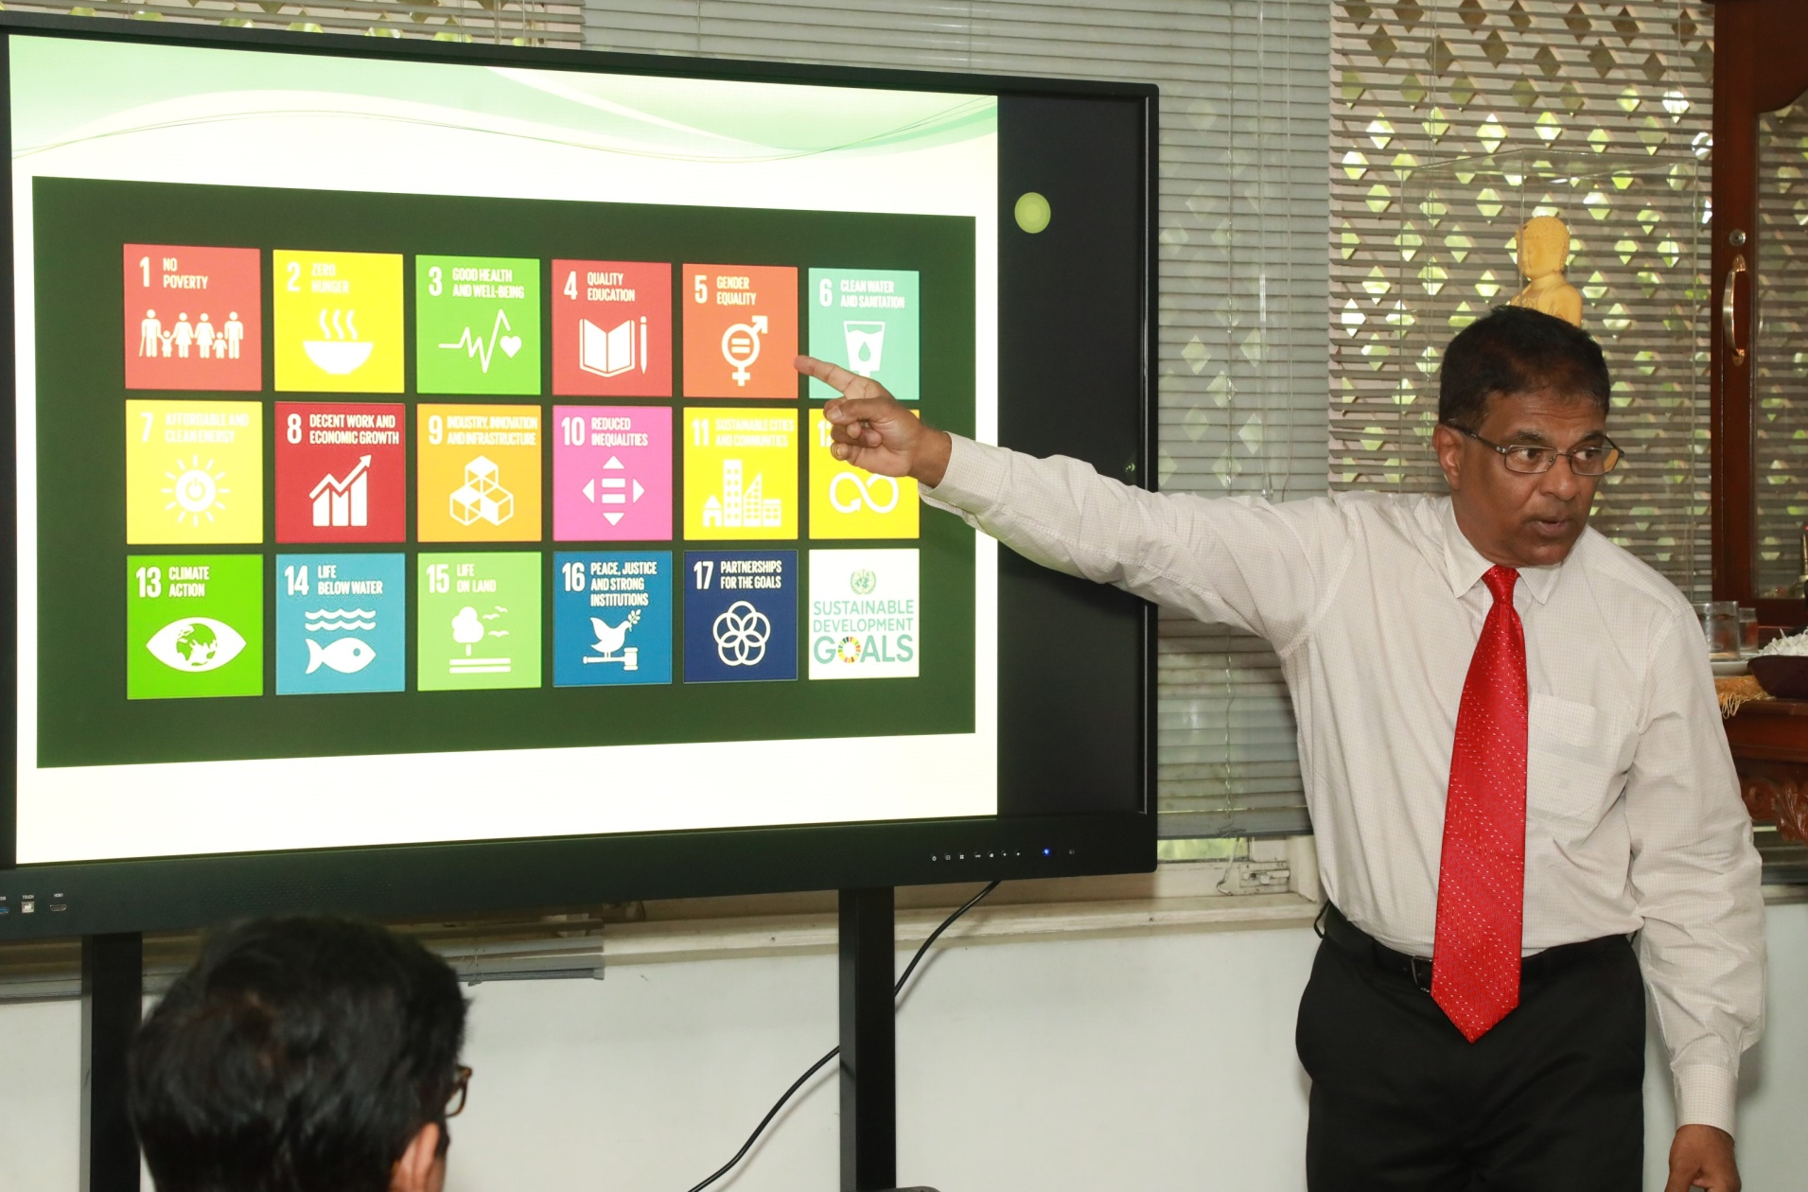
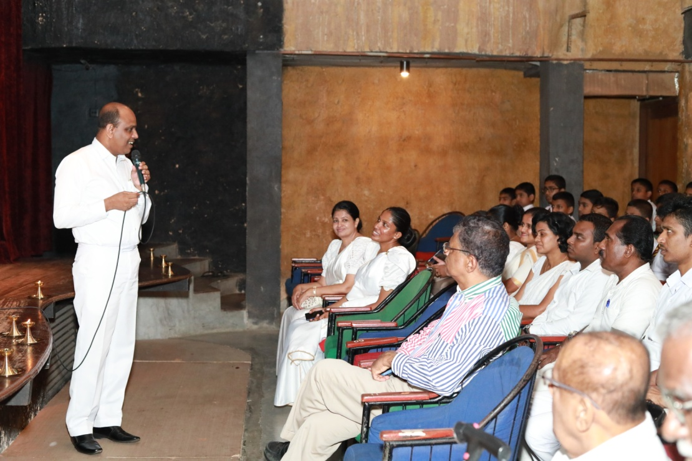
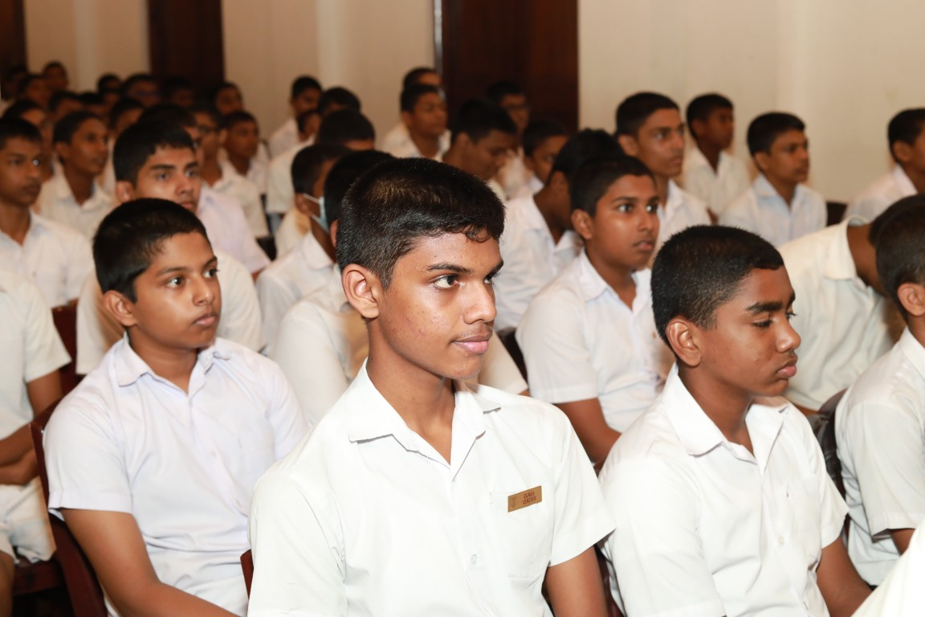

Slide 17
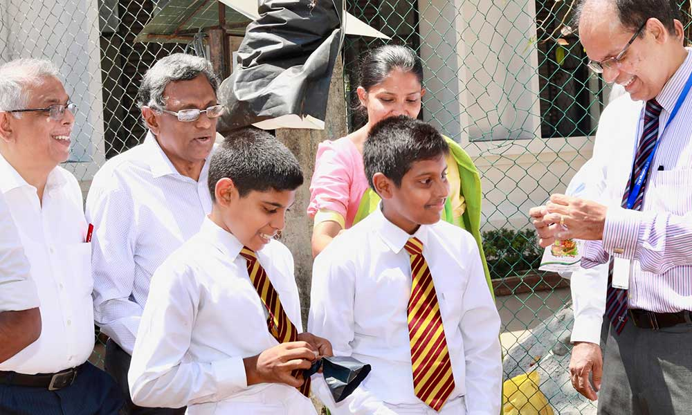
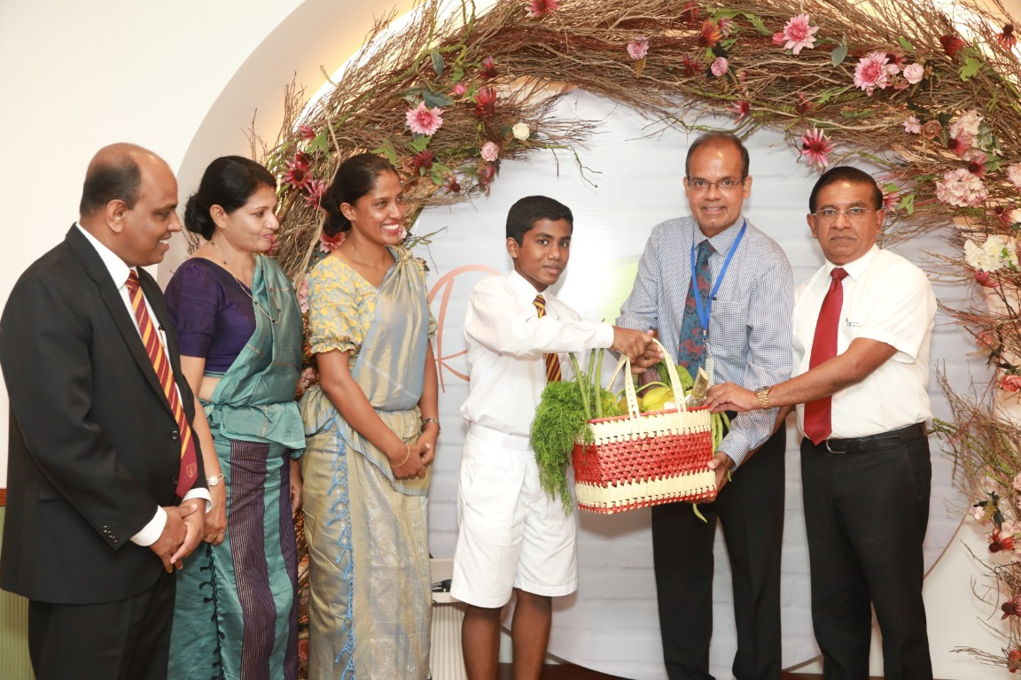
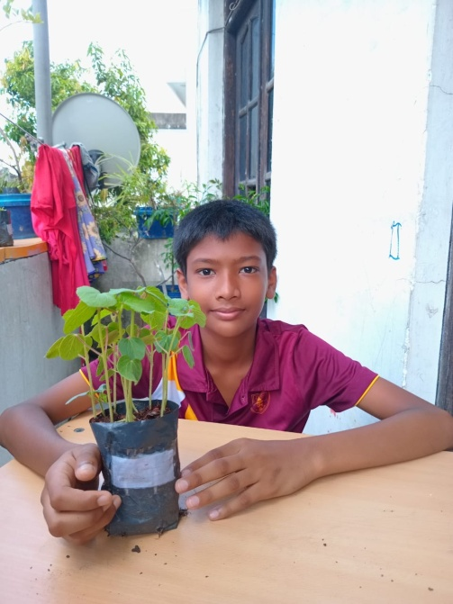
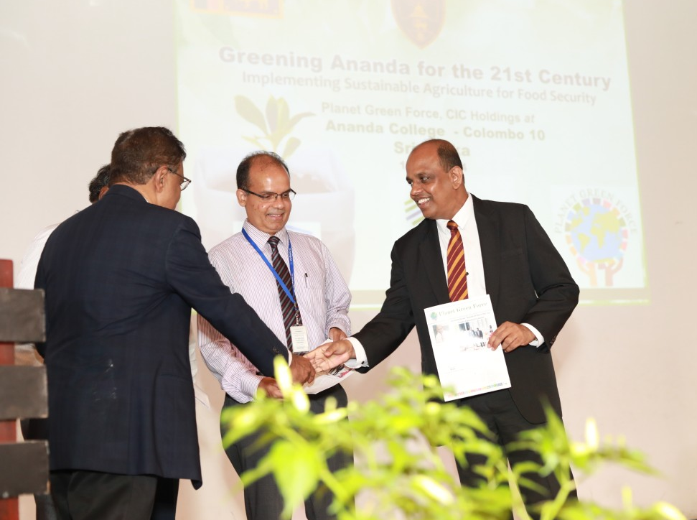
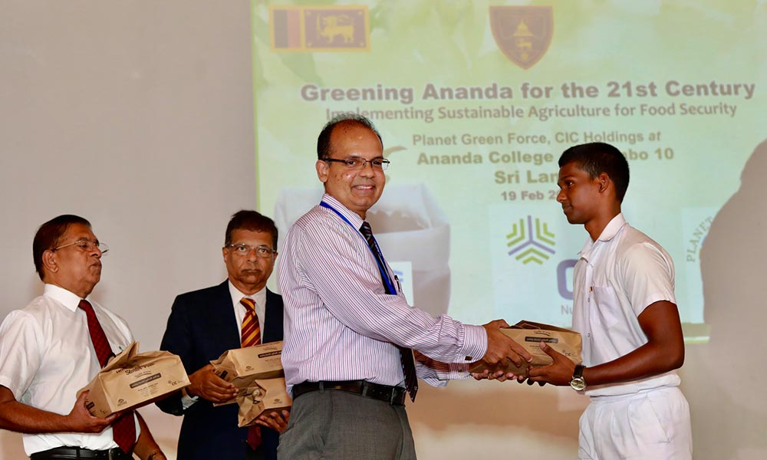
CIC Partnership
Sowing the Seeds of Security

Slide 18
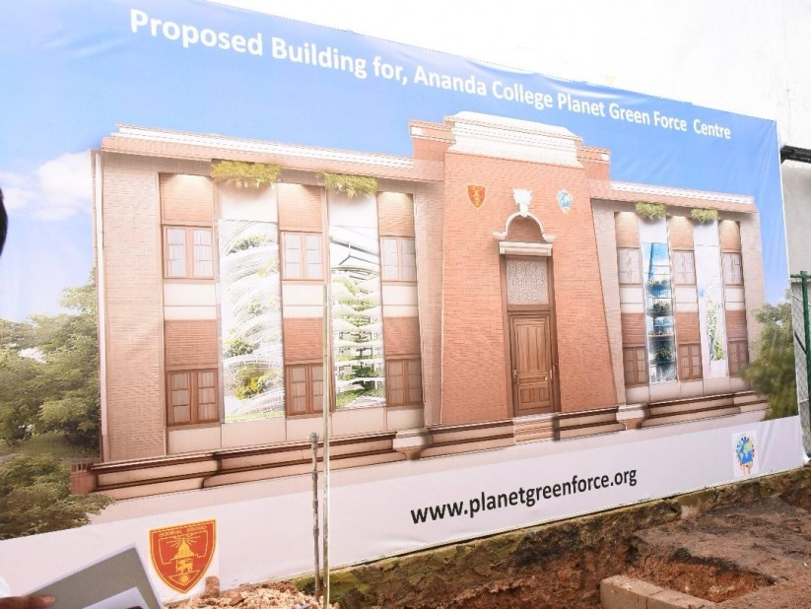

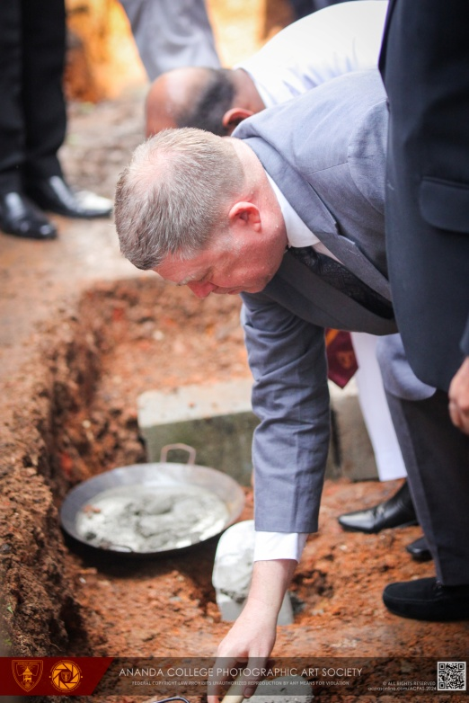
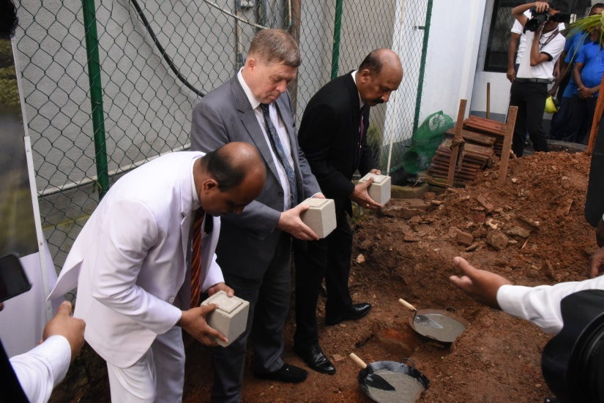
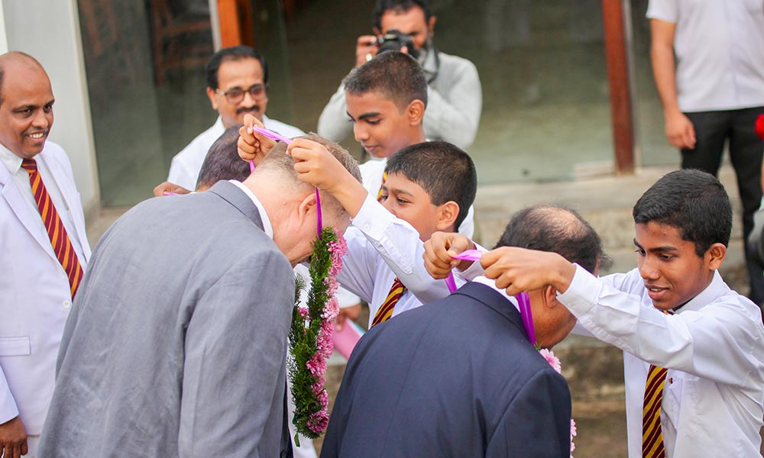
PGF Center Foundation Stone Laying

Slide 19

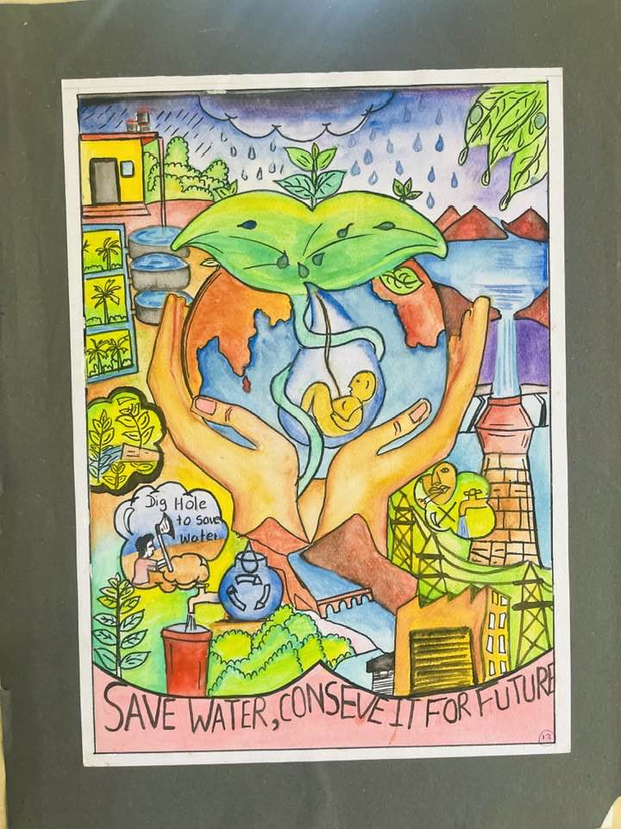
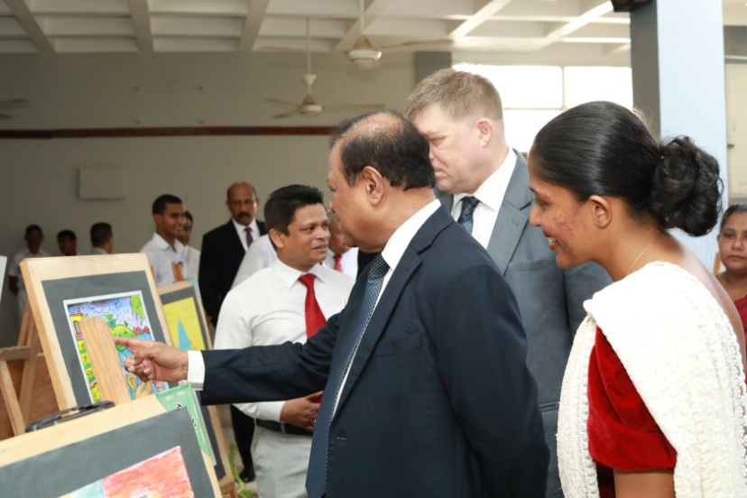
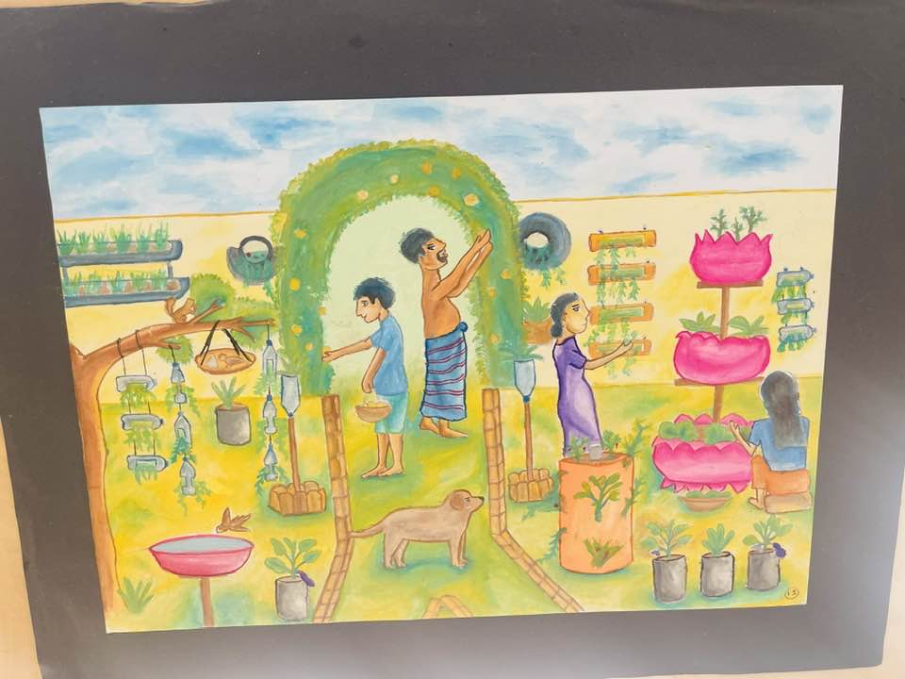
PGF Art Exhibit at Ananda College
Advocacy through Art

Slide 20
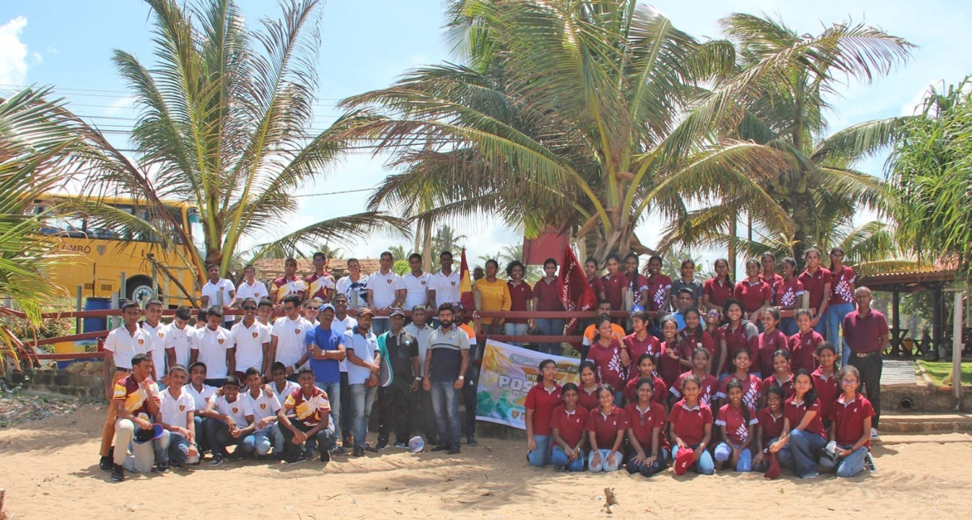
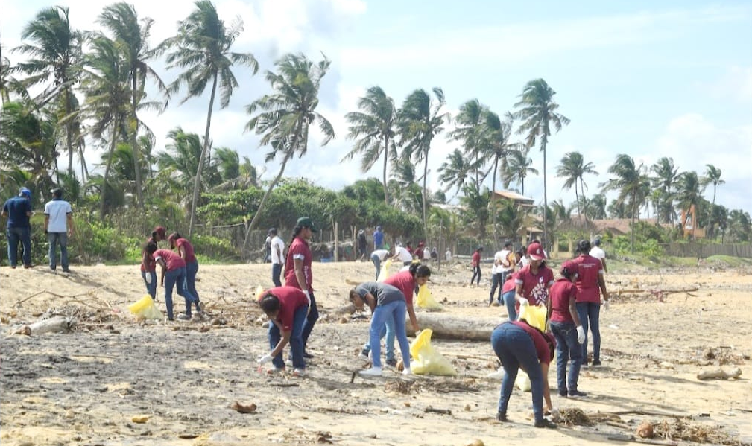
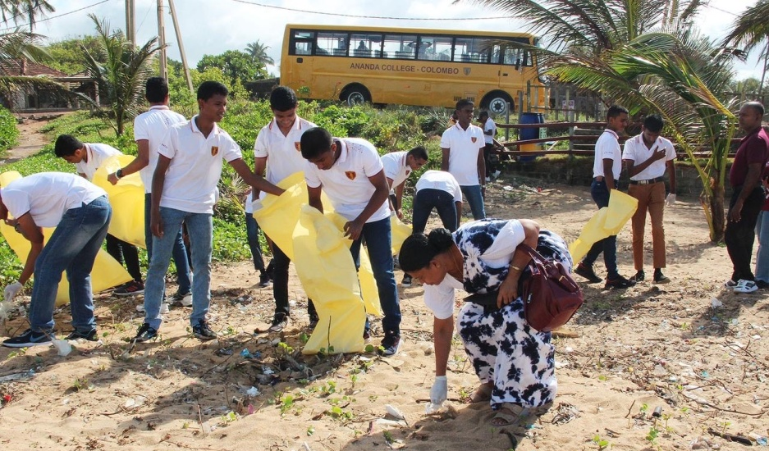
Working Collaboratively Toward
A Cleaner World

Slide 21



Nutritious & DELICIOUS Creations

Slide 22




International Day of GREENING Education
& Chaya Presentation
With UNESCO ASPNet Schools

Slide 23







Slide 24




UNESCO ASPNet Students Receiving
Certificates of Excellence

Slide 25




Field Trip to Sinharaja Rainforest

Slide 26




Progress on Ananda’s Planet Green Force Center

Slide 27


Translation of Climate Science Literacy Posters into Sinhala

Slide 28

There IS a Precedent
Reversing Global Warming IS Possible
YOU Can Make a Difference!

Slide 29


Planet Green Force
“Inspiring & empowering the next generation of GREEN leaders is crucial to building a sustainable future for us all.”
– Harith Wickrema, PGF Founder
Thank You for Your Time
www.planetgreenforce.org

