Slide 1

BE THE GREEN SOLUTION
https://youtu.be/_CIPLOajR58

Slide 2

Planet Green Force Embraces UNESCO Green Academies & Climate Science Literacy
United Nations Educational, Scientific and Cultural Organization
UNESCO's programs contribute to the achievement of the Sustainable Development Goals defined in the 2030 Agenda, adopted by the UN General Assembly in 2015. They include:
UNESCO Green Academies
Engaging young people & their communities to transform existing buildings, for example schools, into climate-resilient structures, equipped with simple, affordable & replicable changes.
Climate Science Literacy
Ensuring the next generation is climate science literate & understands how it must inform our way of life in order to protect it.

Slide 3


Planet Green Force
Sustainability League for Children
Harith Wickrema, Founder

Slide 4
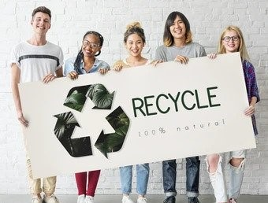
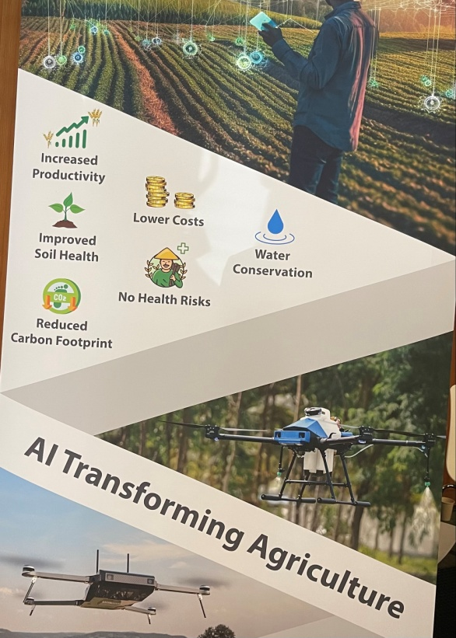
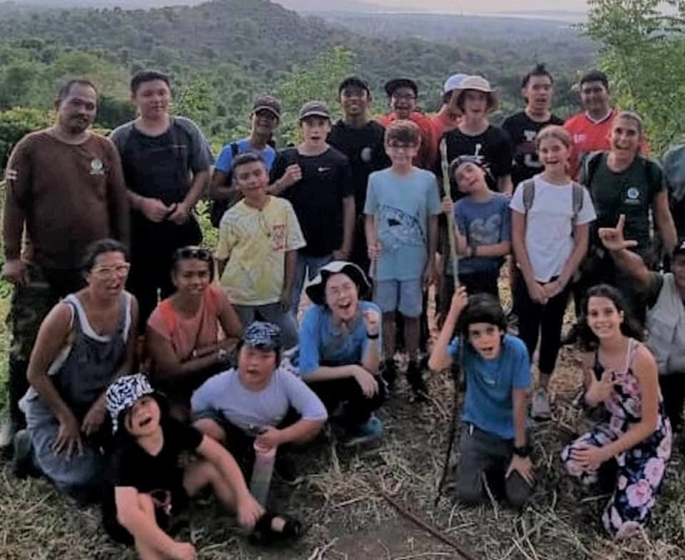

Planet Green Force Mission
In collaboration with UNESCO, Planet Green Force (PGF) is envisioned as a worldwide league for children K-12 with the mission to educate, engage, ignite passion, build awareness and mount meaningful change in eradicating hunger, battling global warming, embracing green initiatives & fighting for environmental justice.
Inspire the next generation of Green LEADERS!

Slide 5
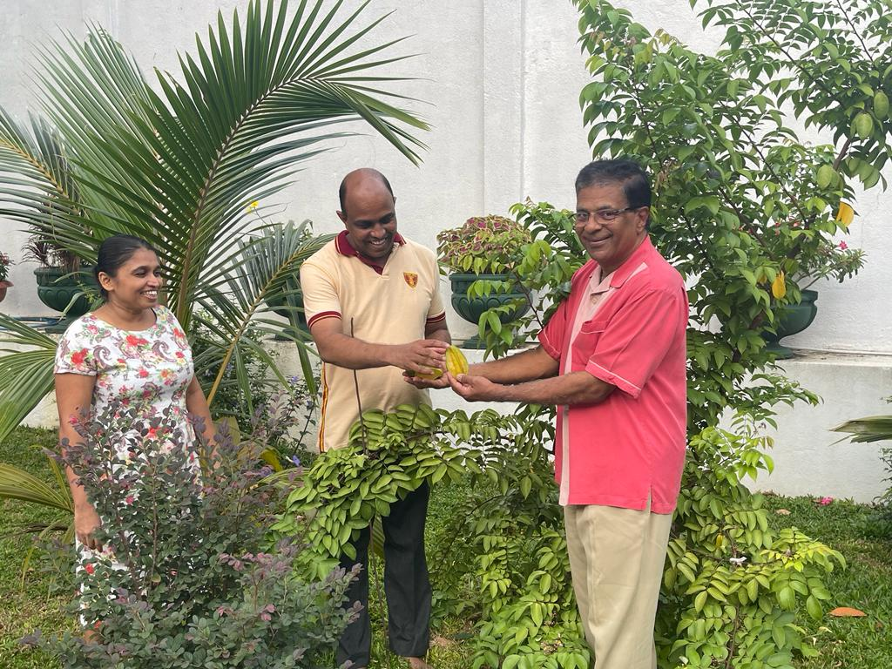


School Pride: Ananda College Makes History as
Very First Planet Green Force Pilot!
Sets new standards in green education and food security programming with the partnership of
Planet Green Force, UNESCO & CIC Holdings PLC
Model to be Replicated Internationally

Slide 6
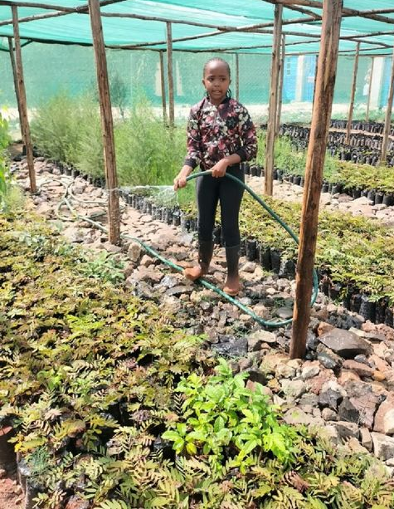
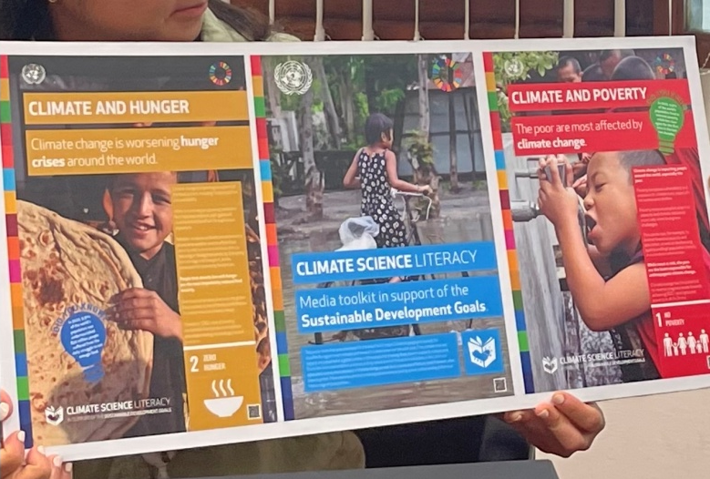
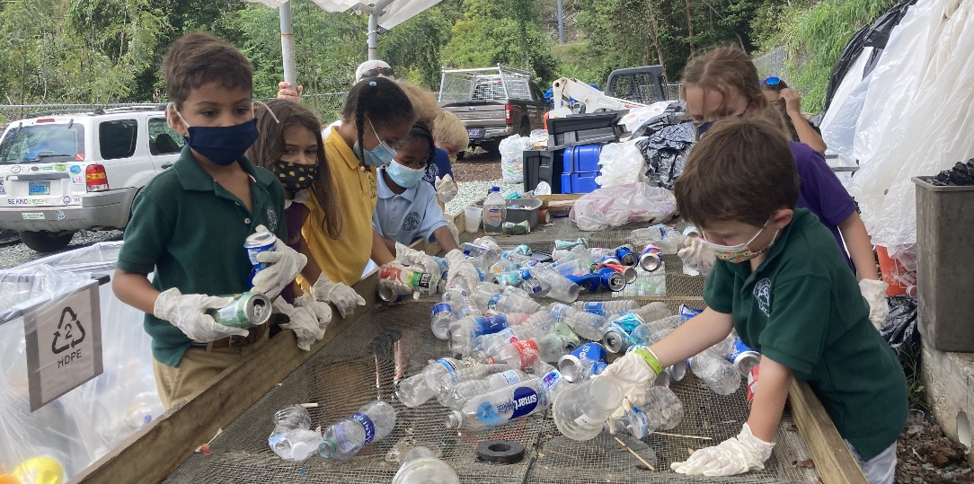
Key Elements of PGF
Experiential learning: age-appropriate environmental/agri concepts in core curriculum, community service, engaging activities & project work; climate science literacy
Green Word of the Day
Badges for completing themed programming tasks/initiatives
Introduction to “AI for Good” technology & vital role of tech
Youth encouraged & rewarded for spreading what they learn: Green Advocacy

Slide 7
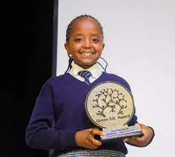
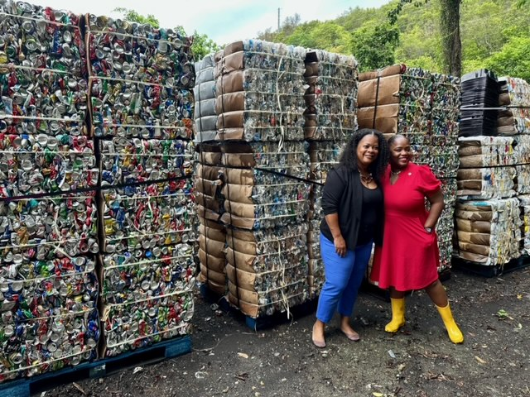
Key Elements of PGF
Regional competitions celebrate, share innovation, motivate. Winners possibly on world stage such as World Economic Forum, UN General Assembly, COP, etc.
Promote creativity, power of teamwork/ collaboration; develop PGF pledge, song, etc.
Where possible, adopt UNESCO’s Green Academies pillars:
  Water Security
  Waste Management
  Clean Energy
  Biomass Production
    Grow/Raise Food = Food Security
    Biofuel Production
Incorporate best practices, top green ed programs

Slide 8
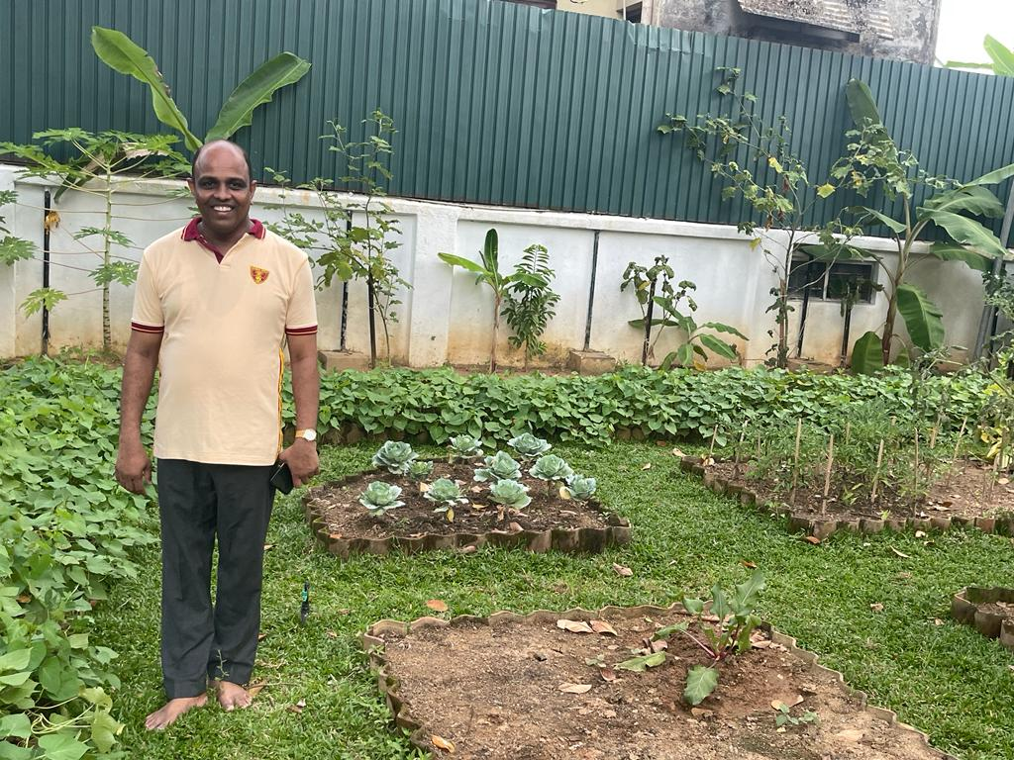
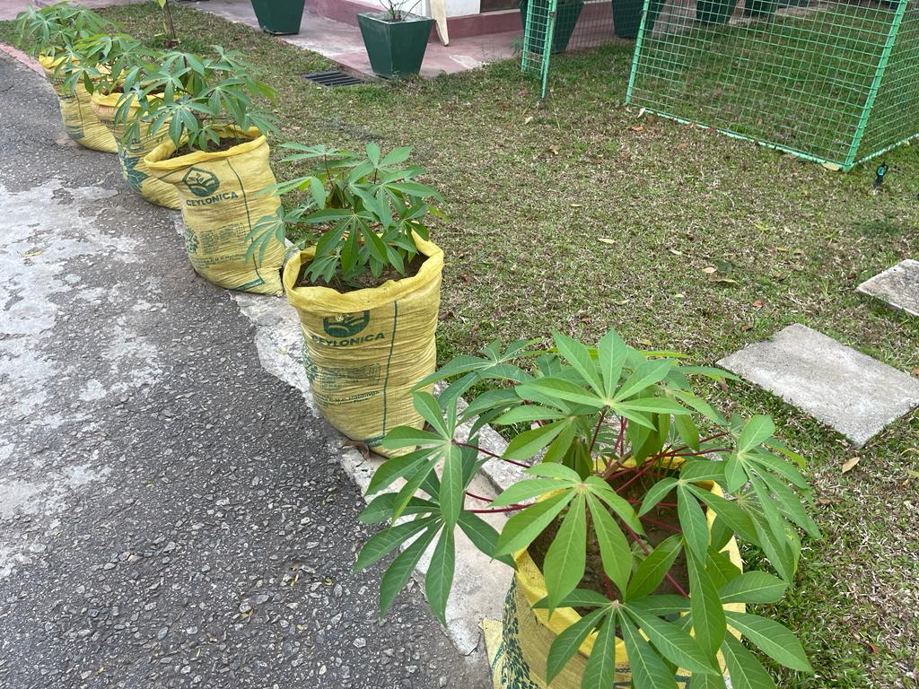
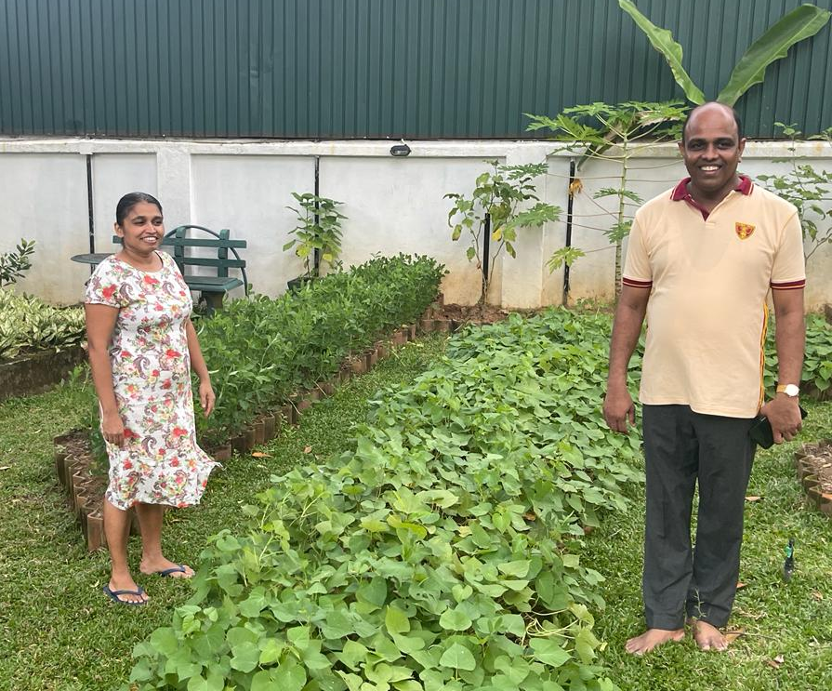
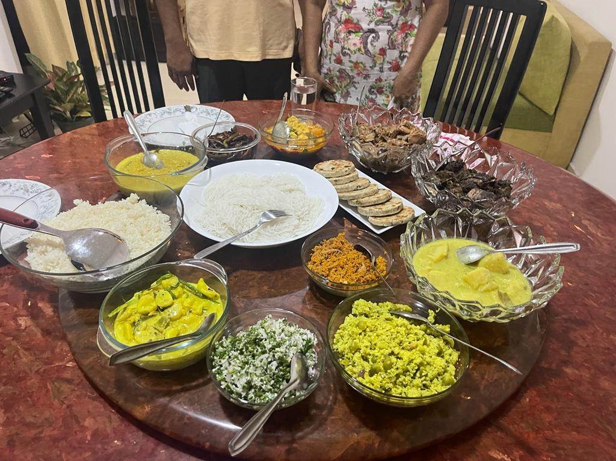
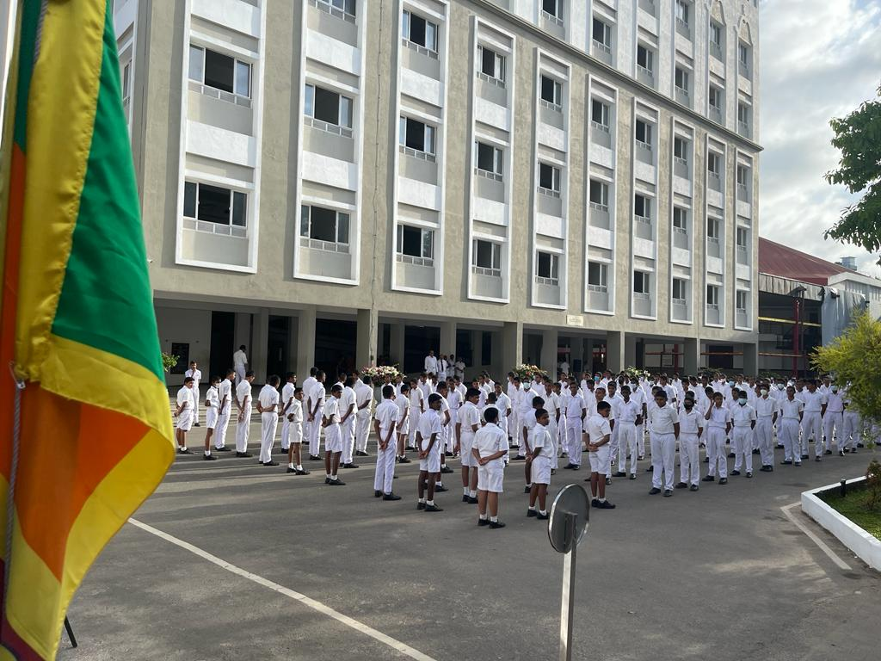
PGF Themed Programming: “Seeds of Security”
Importance of Food Security/Sovereignty
Leading by Example!

Slide 9
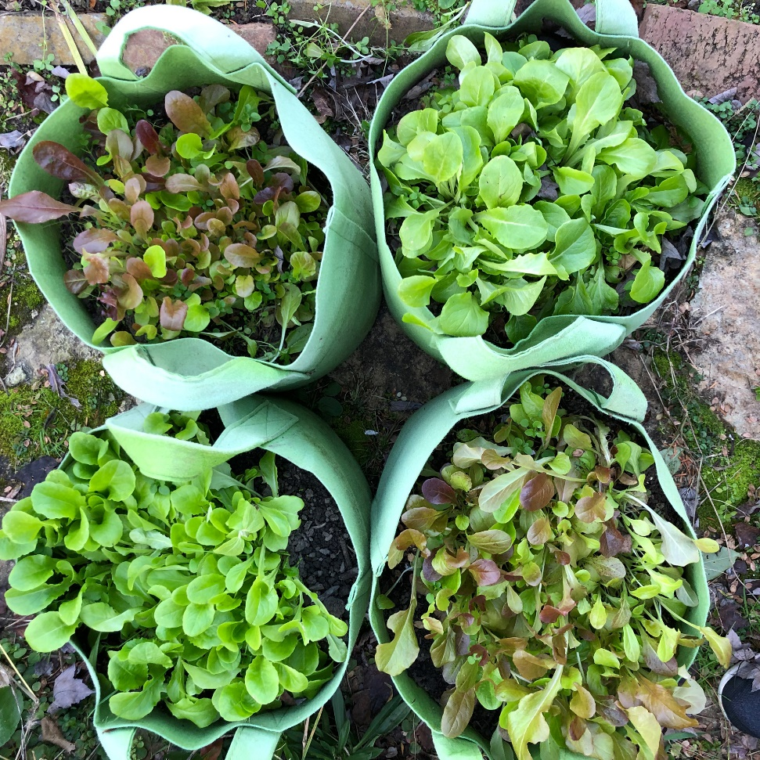
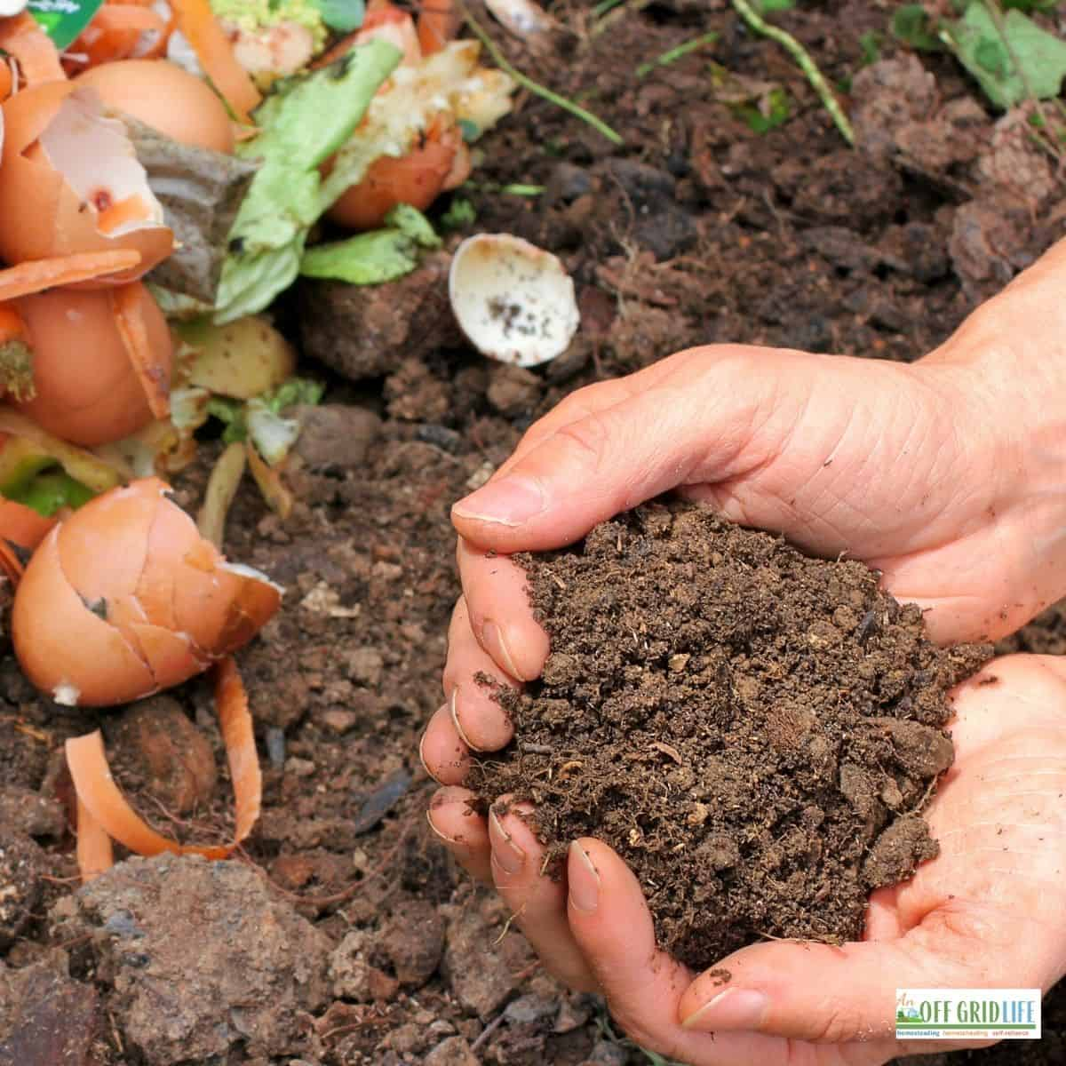
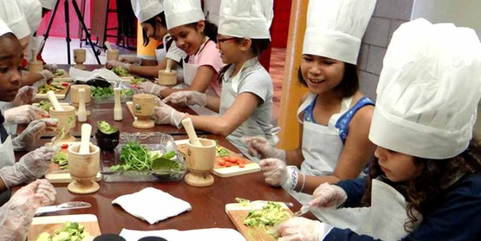
“Seeds of Security”
Grow container gardens: hands-on instruction
Provision of school hydroponics and/or aquaponics, work in school gardens
Intro to composting; start school compost pile/container
Help develop nutritious menu items incorporating “crops”
Sell excess through school marketplaces; help make program self-sufficient
Create opportunity similar to UN Food & Agriculture Organization’s “Global Chef Challenge” / Create cookbook
Field trips to local farms/green markets

Slide 10
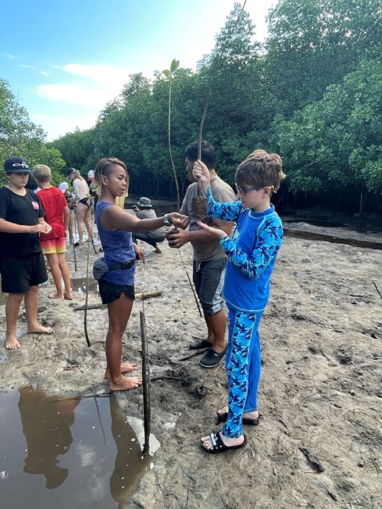
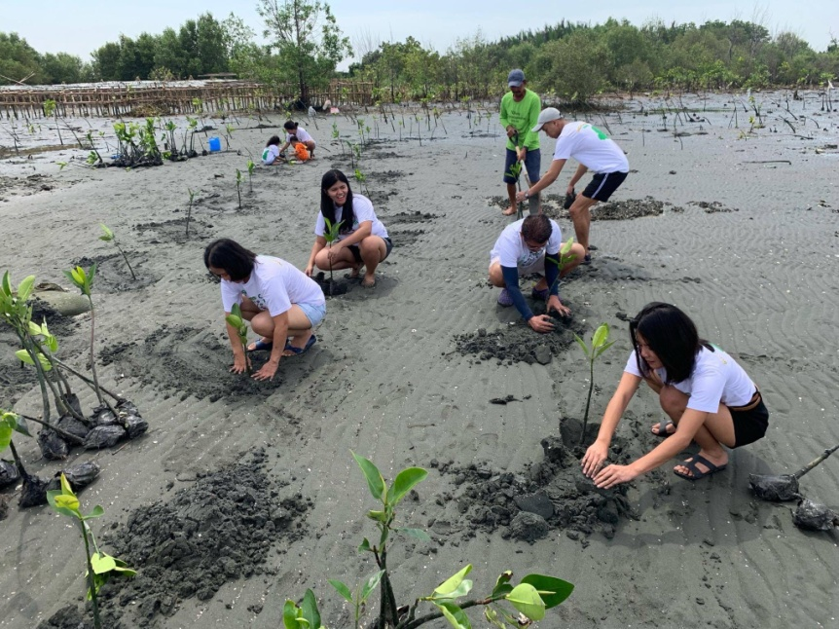
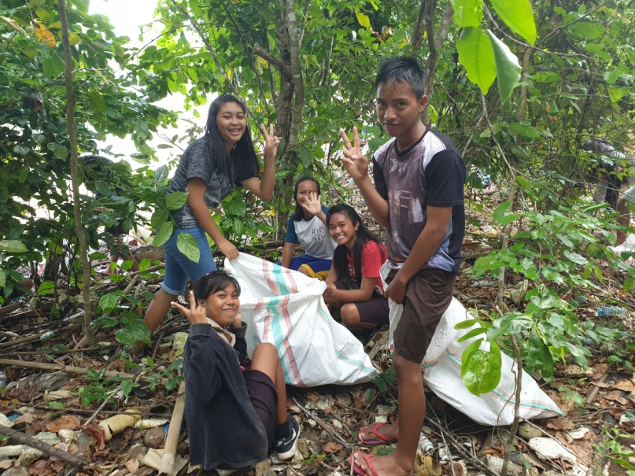
Additional PGF Theme Example: Mangrove Restoration
Importance of mangroves to the ecosystem
Learn science behind how mangroves prevent erosion, purify environment & provide “nurseries” for wildlife
“Adoption” of mangroves including hands-on planting in mangrove forest
Art project creating educational posters on protecting mangroves
Study of wildlife and “I spy” contests for identifying native animals/birds/ plants/underwater life, etc.

Slide 11
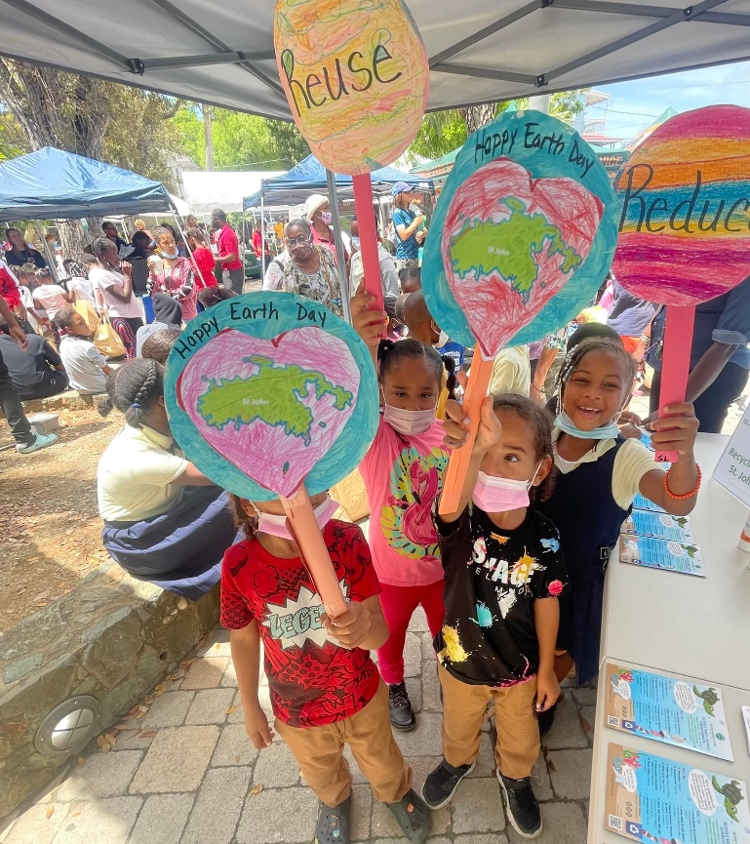
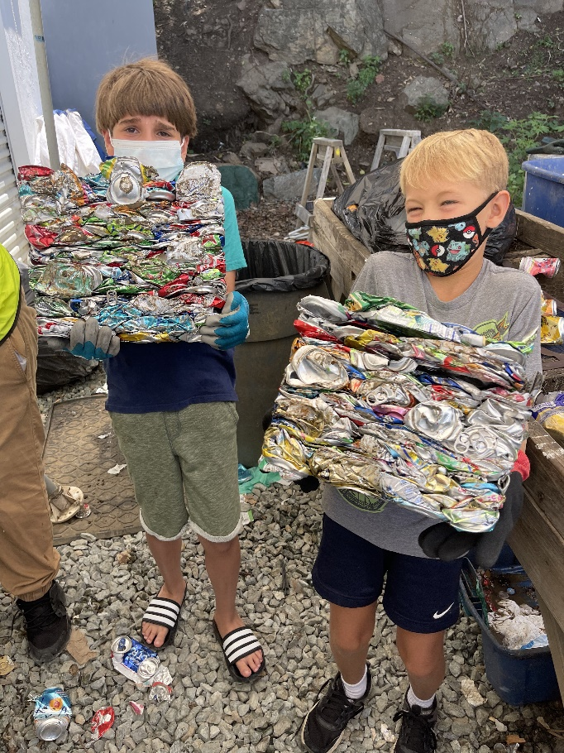
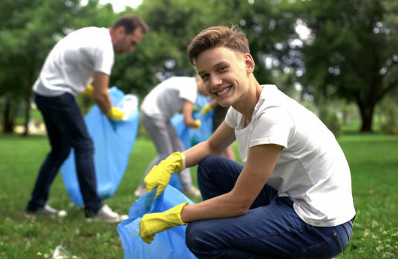
Additional PGF Theme Example: “Four Rs” Program
Importance of following “Rethink, Reduce, Reuse, Recycle”
Collection by troops of recyclable items in community. Consider rewards for the team that collects the most recyclables
Advocacy for community recycling: outreach to local politicians and community encouraging recycling
Cleanups of local beaches and parks
Create artwork or otherwise repurpose what others might think is “trash”

Slide 12
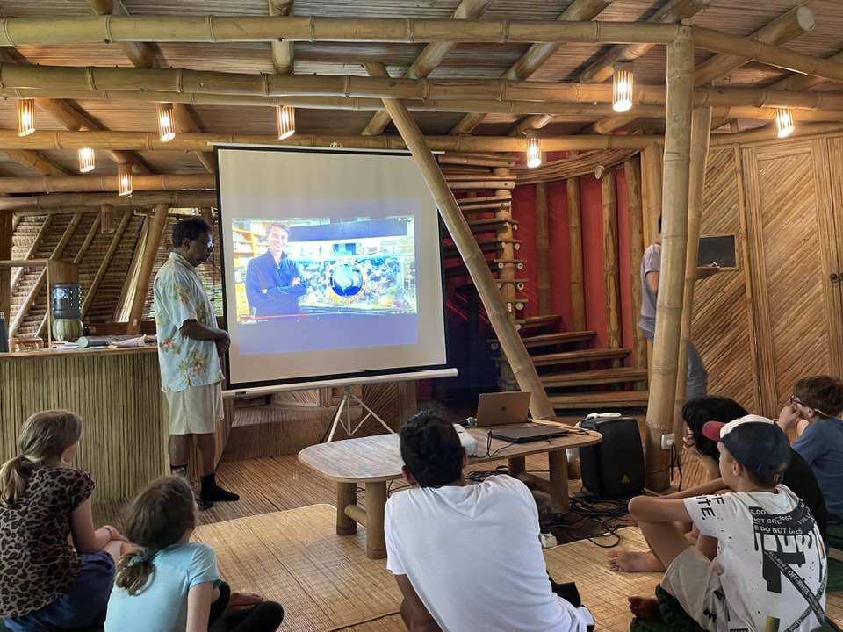
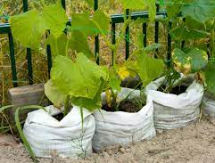
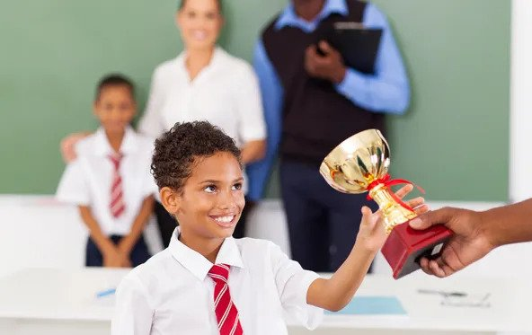
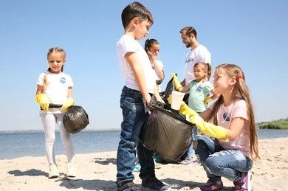
PGF Rollout Plan
Premiere Pilot Program: Ananda College, Sri Lanka
Three – Six USVI Schools as a Pilot Project
With data & success, expansion in Sri Lanka/South Asia
Simultaneous controlled expansion throughout USVI territory, then growth in U.S.
Firm up international partners by soliciting support from UNEP, UN, COP, etc.

Slide 13
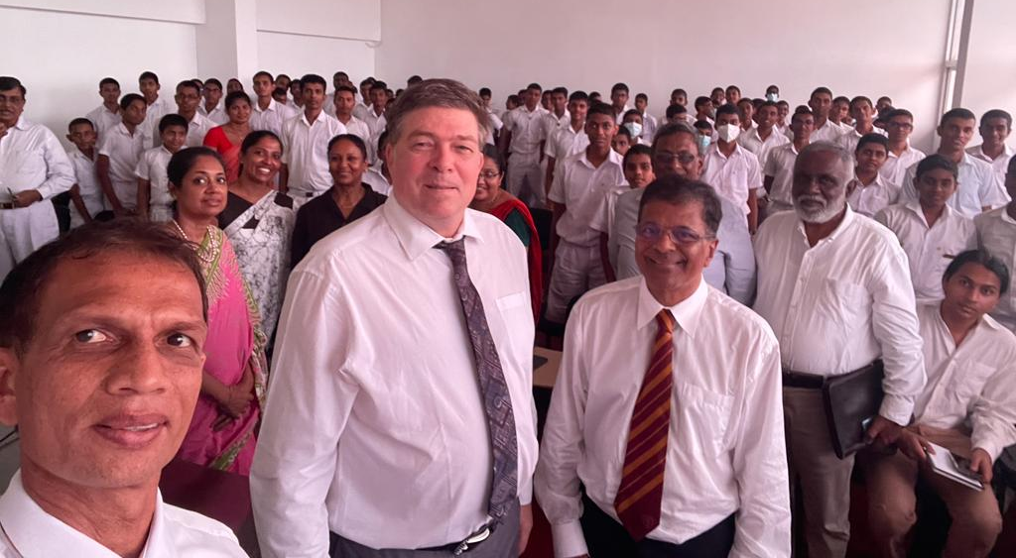
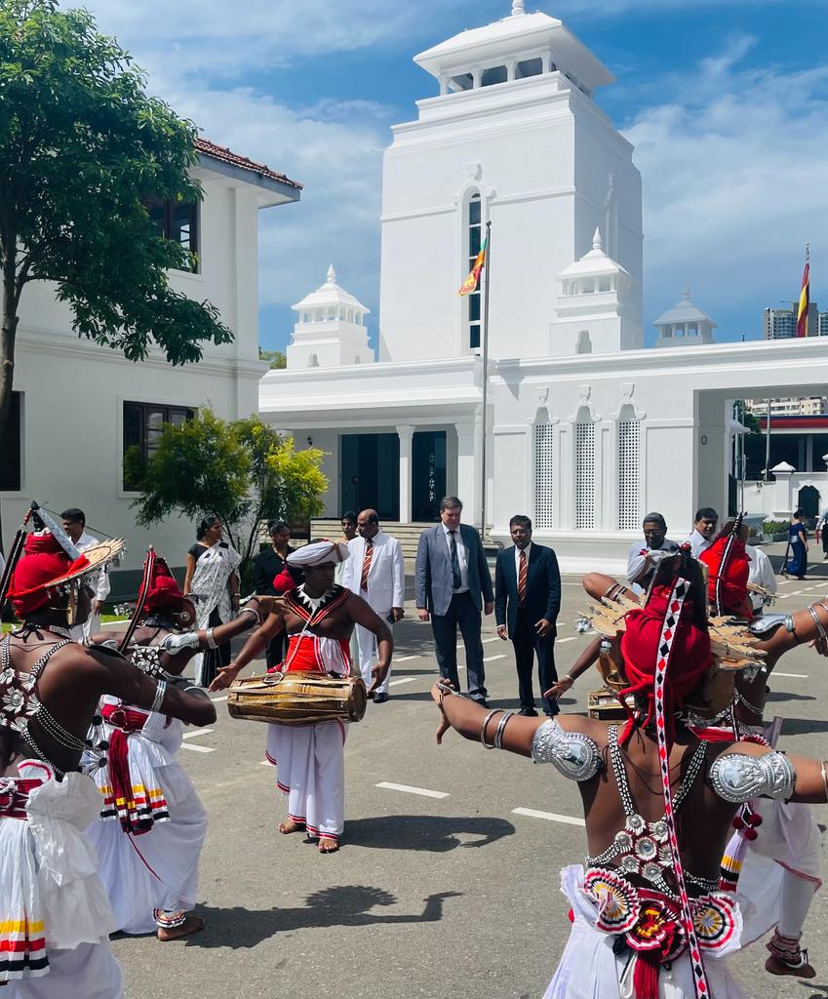
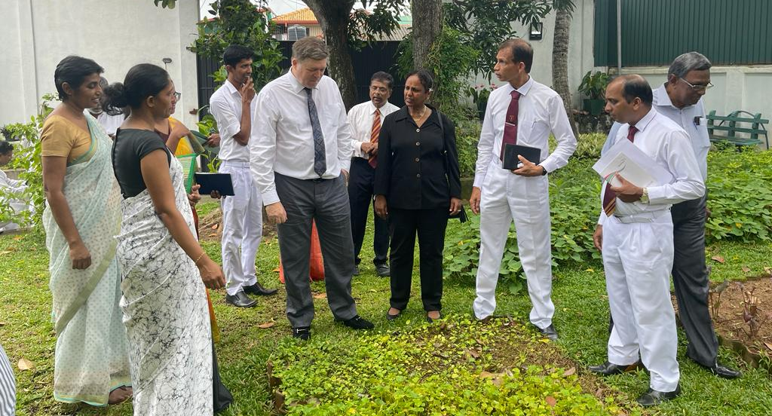
Planet Green Force
“Children are the world’s most valuable resource and its best hope for the future.” – John F. Kennedy
BE the Future You Envision

Slide 14
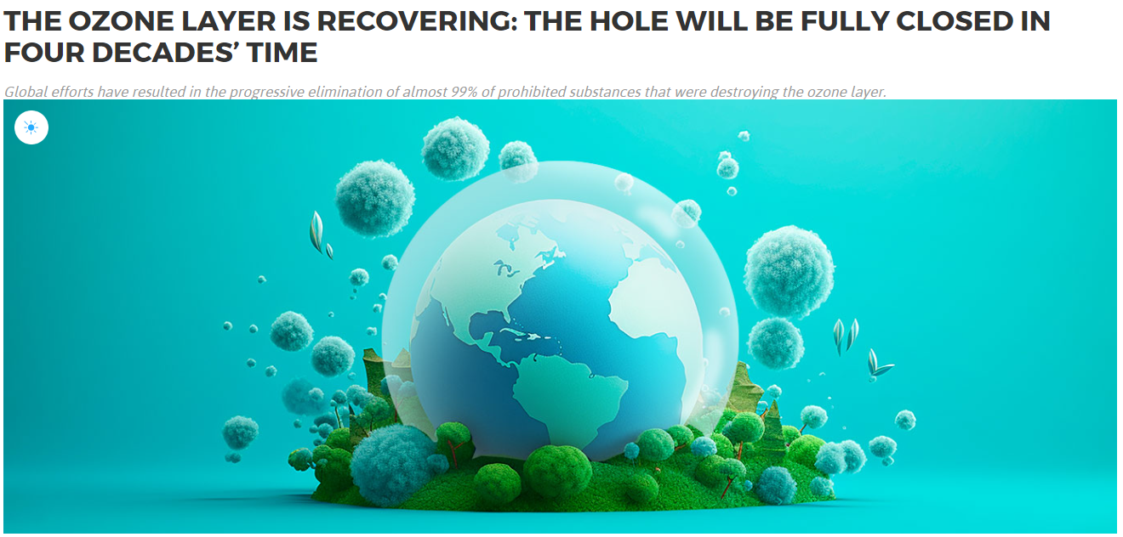
There IS Precedent
Reversing Global Warming IS Possible
YOU Can Make a Difference!

Slide 15


Slide 16
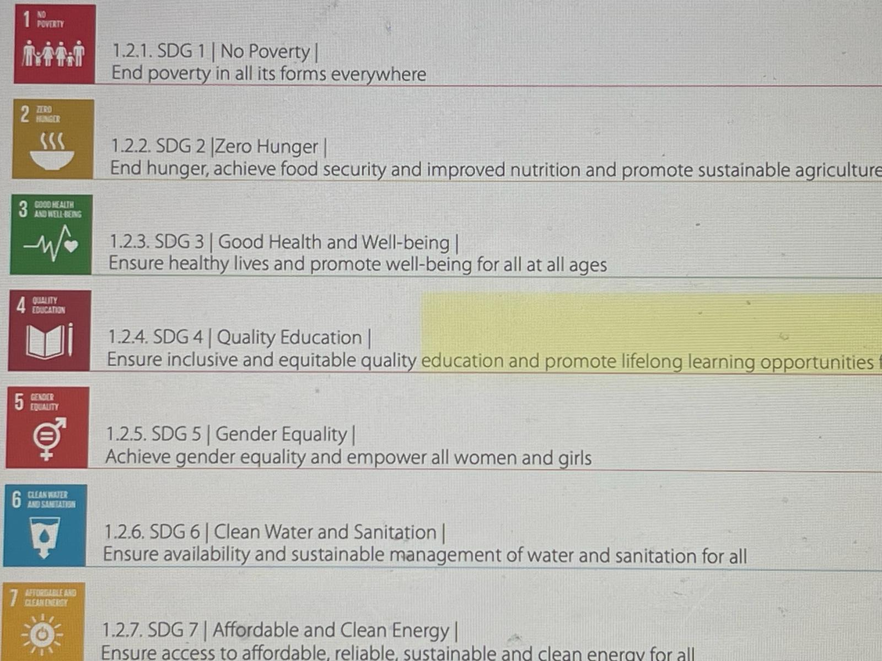

Slide 17
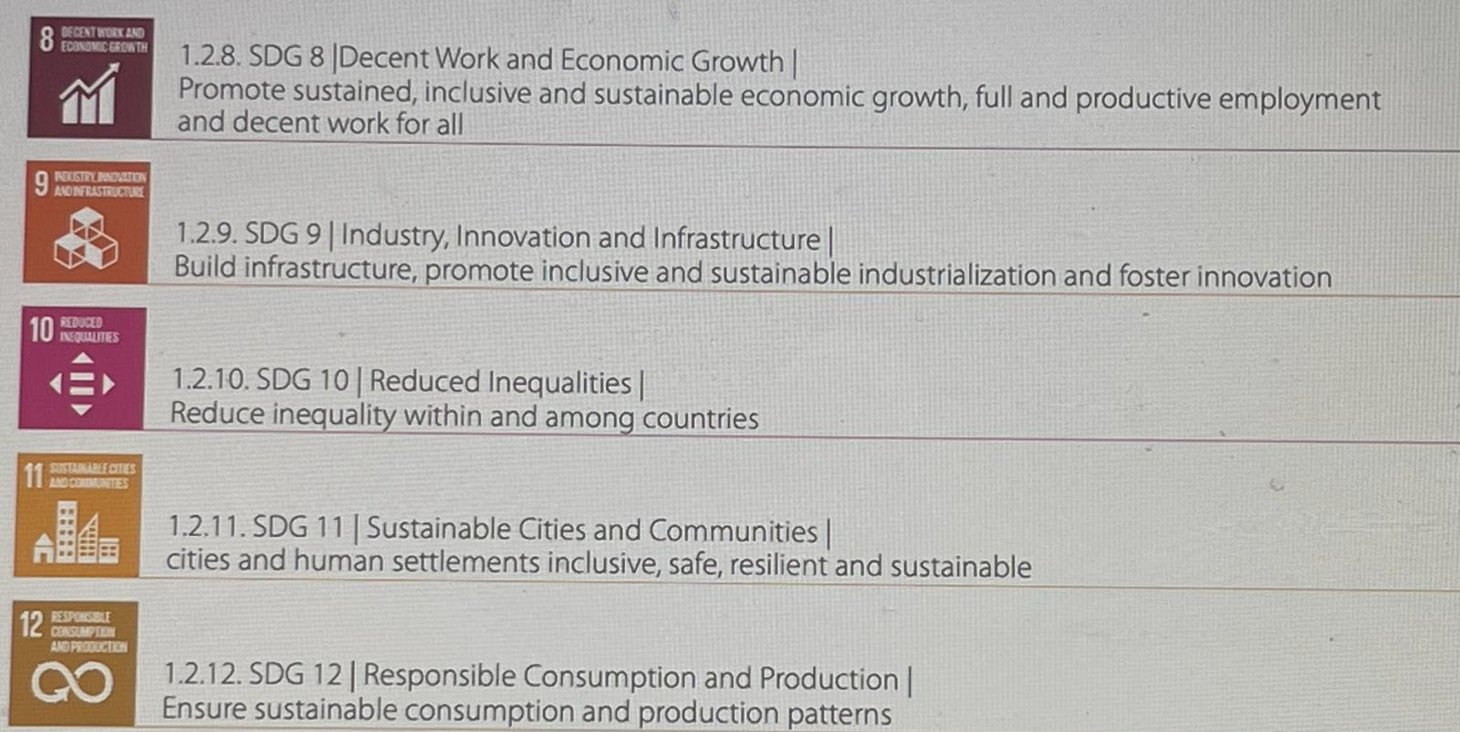

Slide 18
