Slide 1

BE THE GREEN SOLUTION
https://youtu.be/_CIPLOajR58

Slide 2

Planet Green Force Embraces UNESCO
Education Programming
United Nations Educational, Scientific and Cultural Organization
UNESCO's programs contribute to the achievement of the Sustainable Development Goals defined in the 2030 Agenda, adopted by the UN General Assembly in 2015. They include:
UNESCO Greening Education Partnership
Multi-pronged approach including greening schools, greening education, greening teacher training and education system’s capacities, and greening communities.
Climate Science Literacy
Ensuring the next generation is climate science literate & understands how it must inform our way of life in order to protect it.

Slide 3
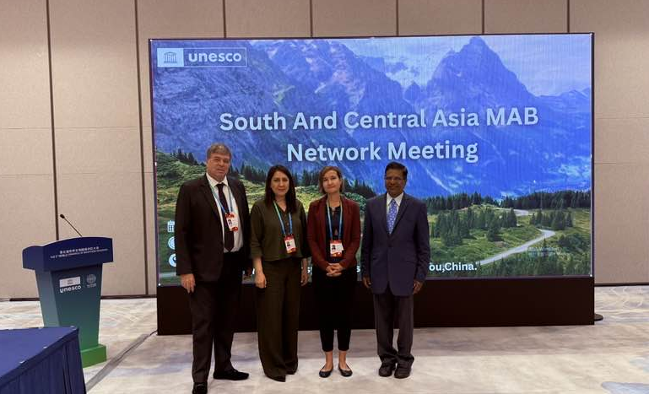
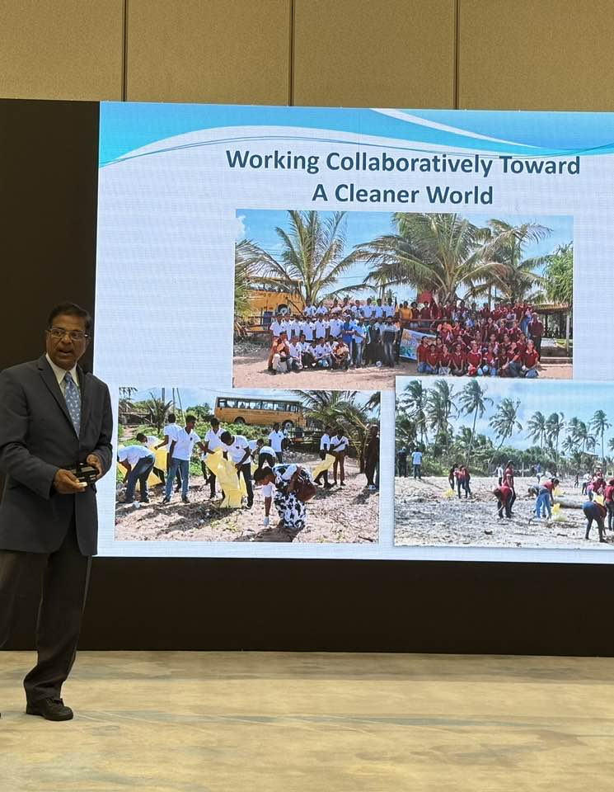
Harith Wickrema, Founder- Planet Green Force
International Platforms
UNESCO 5th World Congress of Biosphere Reserves, Man and the Biosphere, Hangzhou, China,September 2025
12th World Environmental Education Congress (WEEC), Abu Dhabi, United Arab Emirates, Jan/Feb 2024
SITE Global Conference, Istanbul, Turkey, February 2024
EPA Farm, Ranch & Rural Community Advisory Conference, Washington, DC, January 2023

Slide 4
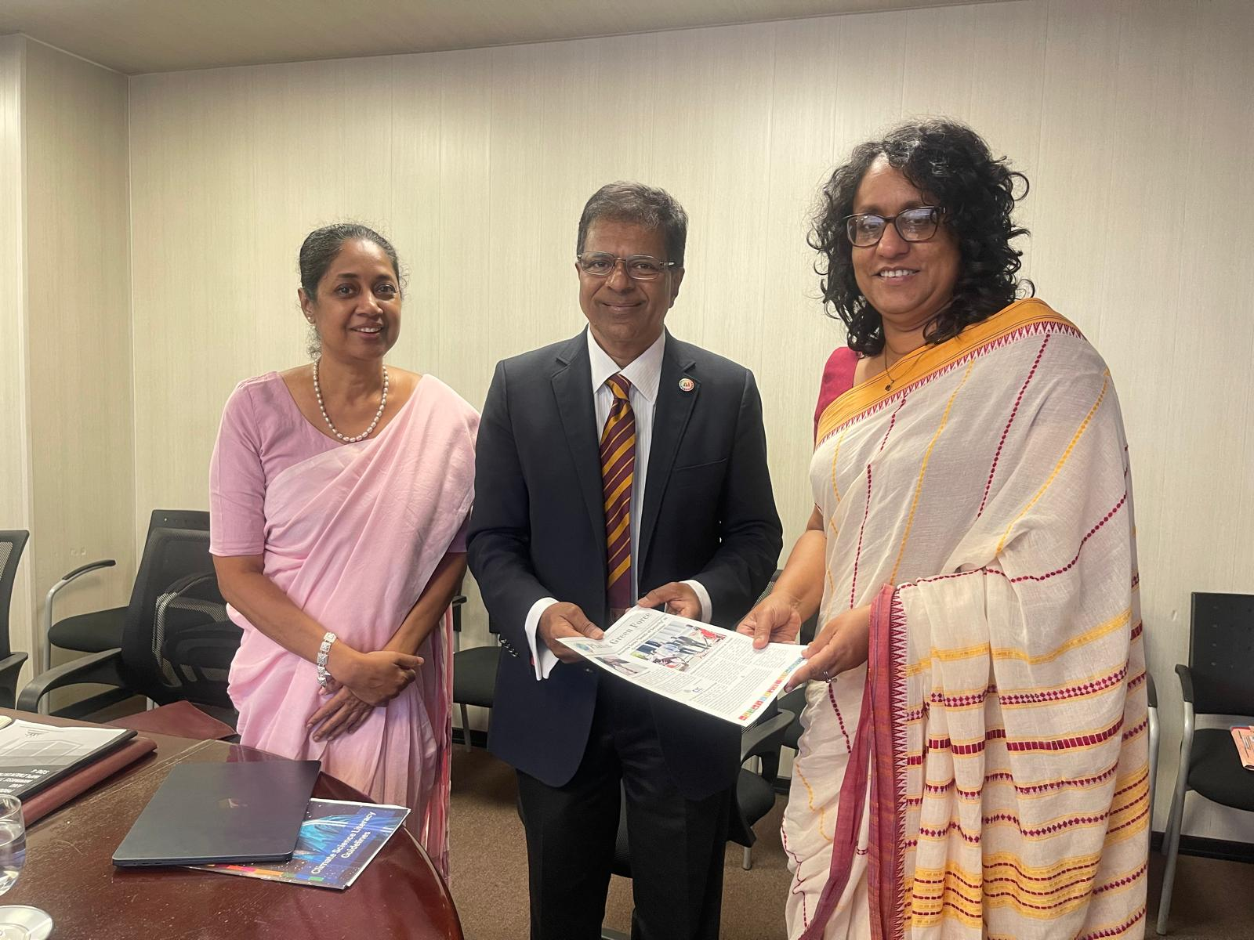

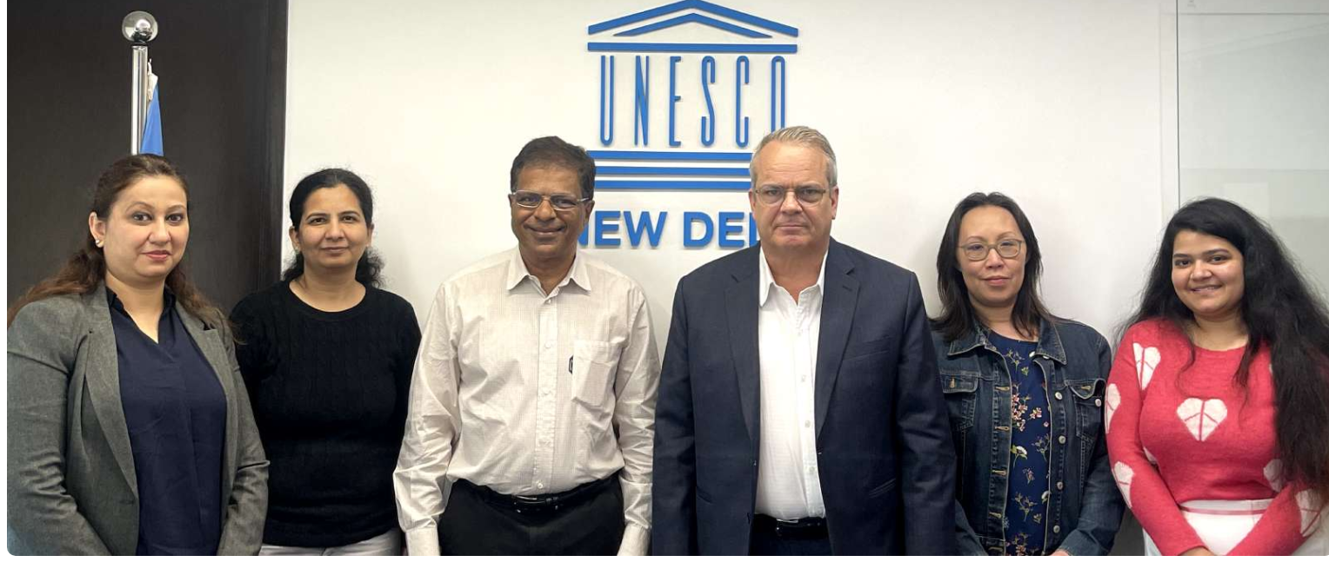
Consultations with Key Government and UN Stakeholders

Slide 5
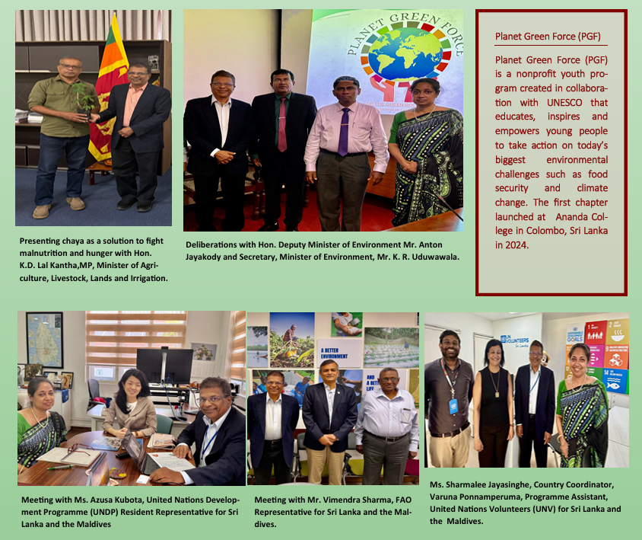

Slide 6
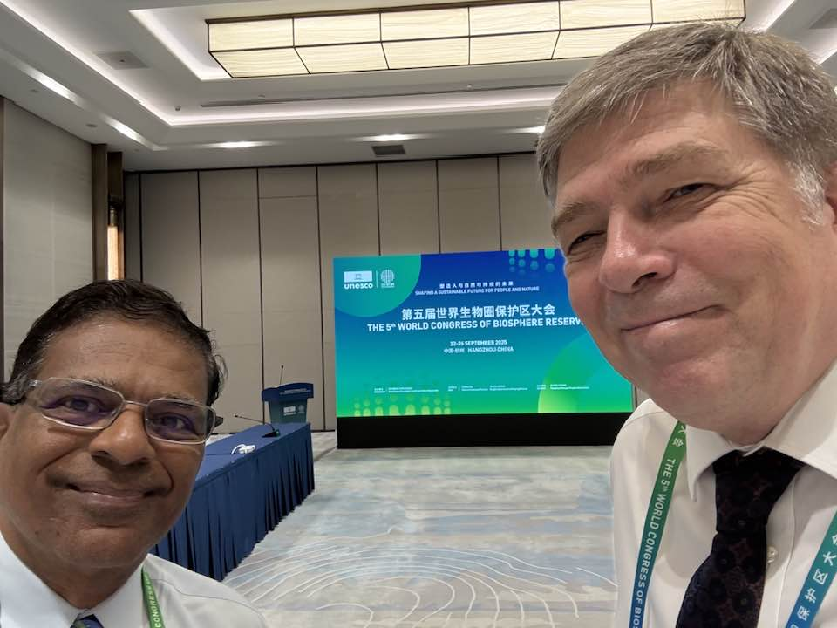
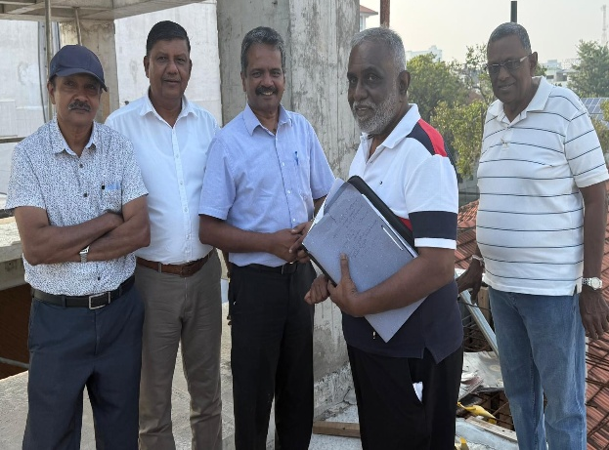
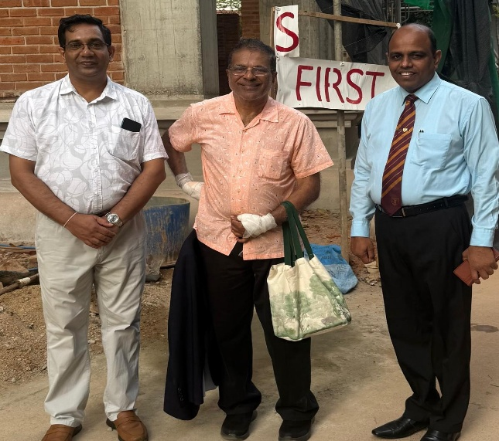
Leading International and National Specialists
Benno Boer, Chief, Natural Sciences Unit, UNESCO South Asia Regional Office
Dr. Ranil Senanayake, International Specialist on Analog Forestry, Chairman, Earth Restoration
Prof. Buddhi Marambe
Senior Professor Department of Crop Science, Faculty of Agriculture, University of Peradeniya
Prof. Lalith Rajapaksha, Director/Centre Chairman (UNESO Madanjeet Singh Centre for South Asia Water Management (UMCSAWM) and UNESCO Chair on Sustainable Water Resources Management in South Asia
Prof. W.A. Palitha Weerakkody Senior Professor of Horticulture, Faculty of Agriculture, University of Peradeniya
Prof. Saman Athauda
Professor of Aquaculture & Fisheries, University of Peradeniya
Prof. Athula Ginige, Professor of Information Technology at Western Sydney University.

Slide 7

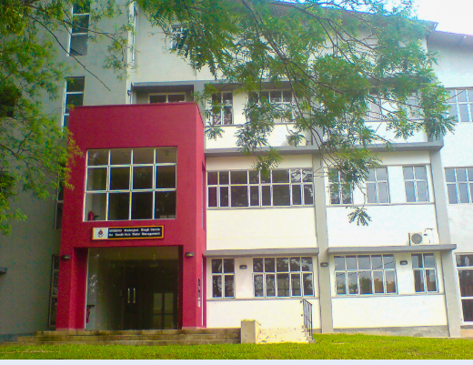
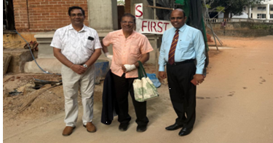
MoU between UNESCO Madanjeet Singh Centre for South Asia Water Management (UMCSAWM) and Ananda College with PGF
UMCSAWM, as a UNESCO supported regional centre and the UNESCO Chair on Sustainable Water Resources Management in South Asia, plays a strategic role in advancing education, research, and capacity building across the region.
The proposed MoU aims to with Ananda College and PGF:
•Strengthen youth leadership in sustainability and climate action;
•Enhance water education pathways linking school level initiatives with higher education and research;
•Support national and regional priorities on climate resilience, environmental stewardship, and sustainable development.

Slide 8
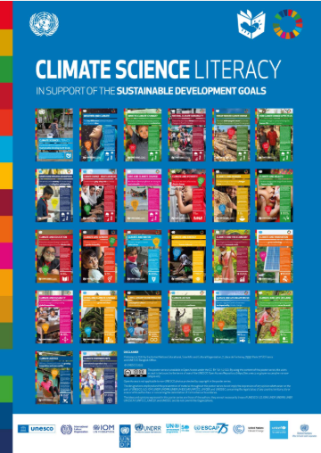

Translation of UN Climate Change Posters jointly developed by UNESCO, ILO, IOM, UNDP, UNDRR, UNEP, UN ESCAP, UNFCCC, UNICEF, and UNOSSC,to Sinhala in collaboration with the UNESCO Sri Lanka National Commission

Slide 9

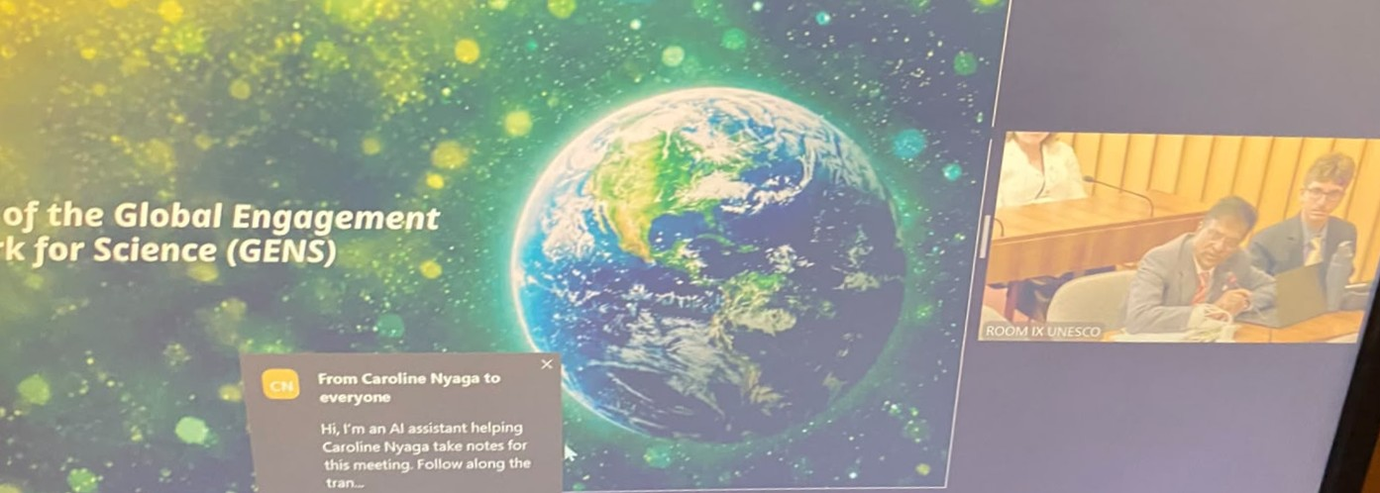
Commitment by Planet Green Force (PGF), Ananda College to host the South Asia program for the UNESCO’s Global Engagement Network for Science (GENS) in June 2027, for science clubs, STEM/STEAM education, and the wider Sri Lankan school network.

Slide 10


Planet Green Force (PGF) Named as an ACCREDITATION SCHEME ORGANIZER for UNESCO GEP at Third Quarterly Working Group Meeting of the GEP, 9-15-2026
Rooted in the principles of Education for Sustainable Development (ESD), PGF supports schools to embed sustainability through a structured, learner‑led, whole‑institution approach aligned with UNESCO’s Green School Quality Standard. In addition, PGF also reaches its tentacles into the community via extended family networks. This supports the greening of entire villages, cities, etc.
PGF evaluates schools including School Governance, Facilities & Operations, Teaching & Learning, and Community Engagement.

Slide 11
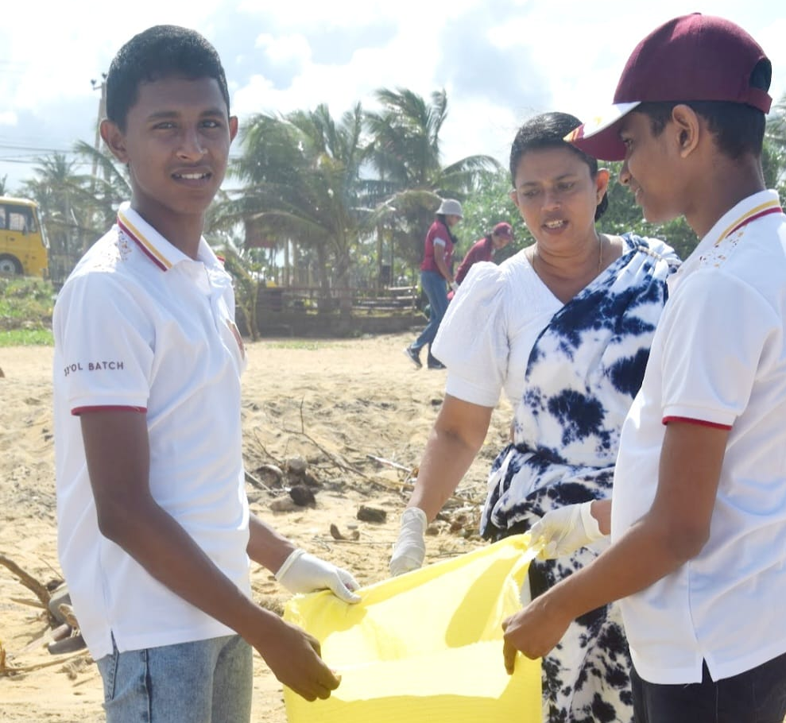
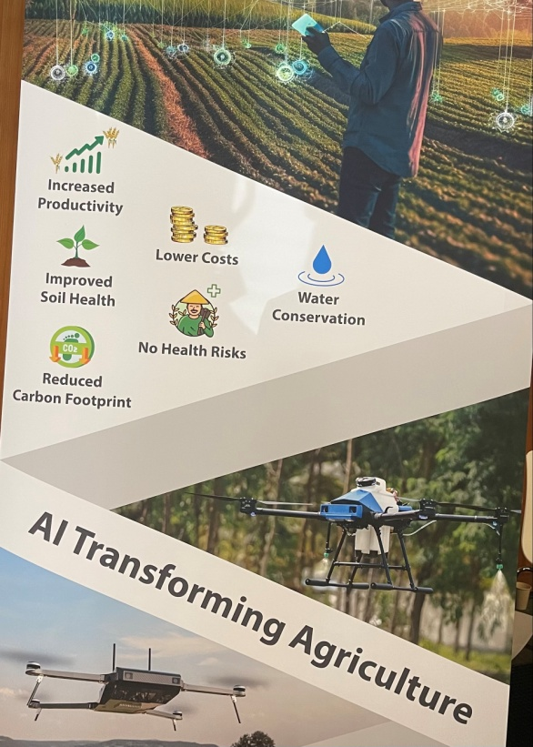
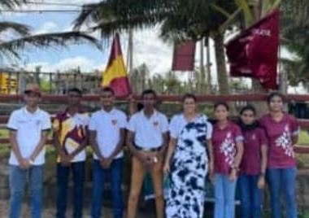

Planet Green Force (PGF) Mission
With the issue of global warming top of mind, nonprofit PGF, in collaboration with UNESCO, is a worldwide league for children PreK-13 that educates, ignites passion & builds awareness in order to mount meaningful change in eradicating hunger (food security), battling global warming, embracing green initiatives & supporting the UN’s Sustainable Development Goals (SDGs) and UNESCO’s Climate Science Literacy & Green Academies’ pillars. It allows youth to reach their full potential as agents of change, encouraging others to emulate this behavior.
Inspire the next generation of Green LEADERS!

Slide 12
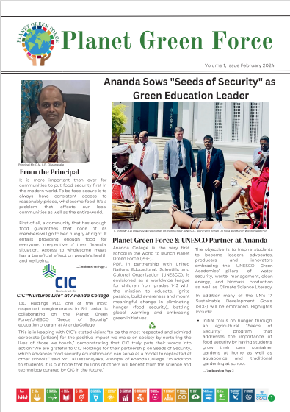
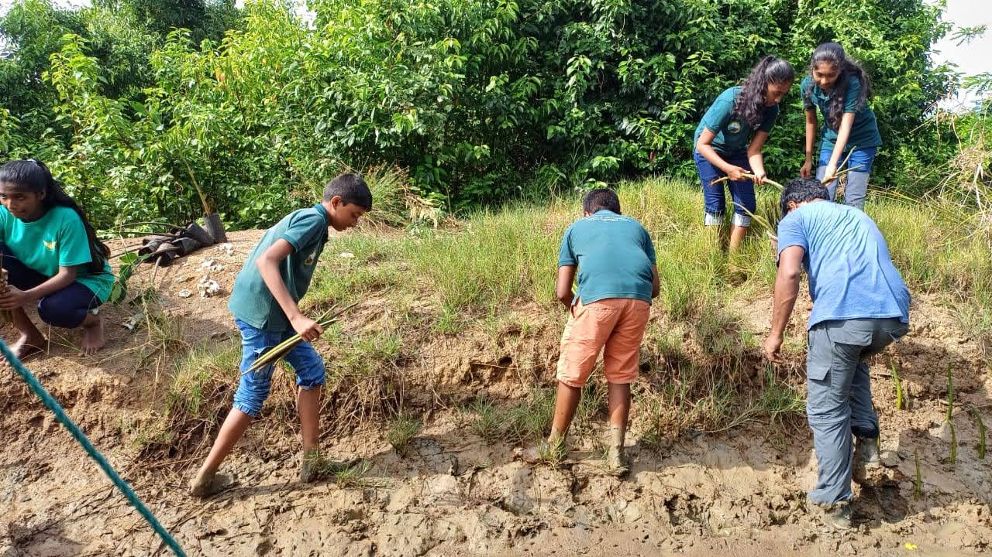
Key Elements of PGF
Experiential learning: age-appropriate environmental/agri concepts in core curriculum, engaging activities & projects
Embrace UN’s Sustainable Development Goals
Green Word of the Day/Week
Guest speakers/field trips
Adopt UNESCO Climate Science Literacy as well as Green Academies’ pillars:
  Water Security
  Waste Management
  Clean Energy
  Biomass Production

Slide 13
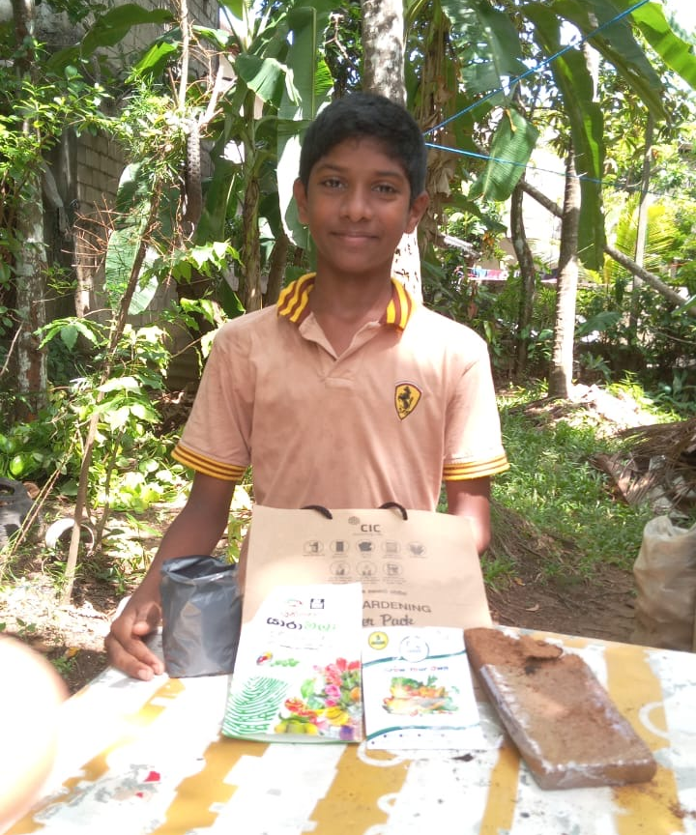
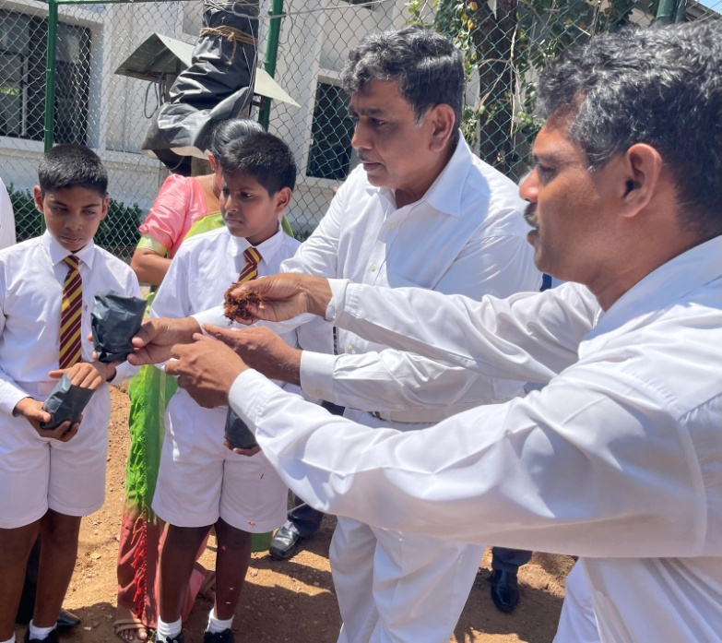
Key Elements of PGF
Introduction to “AI for Good” technology & vital role of tech
Youth encouraged & rewarded for spreading green message and “practicing what they preach”: Green Advocacy
Regional competitions celebrate, share innovation, motivate
Promote creativity, power of teamwork/ collaboration; develop PGF pledge, song, etc.
Incorporate best practices, top green ed programs

Slide 14
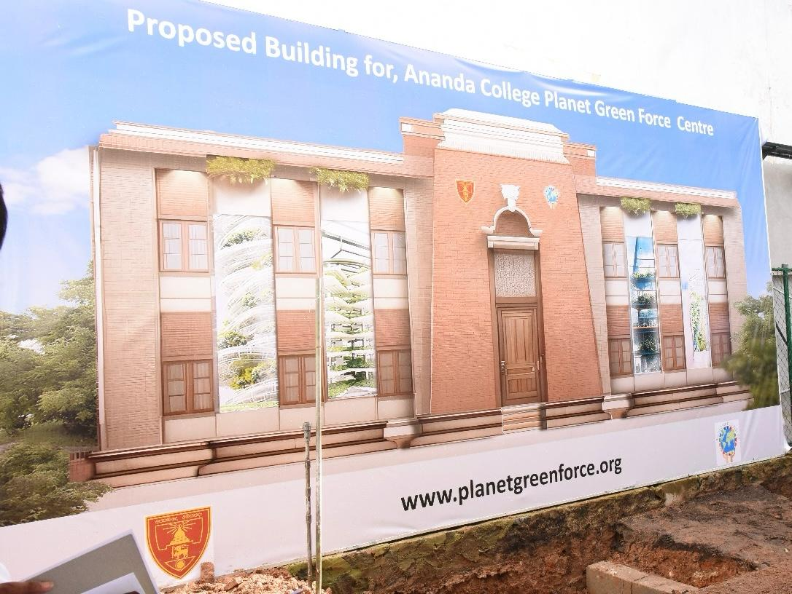
First Planet Green Force Center to Launch at Ananda College
Innovative eco-learning, teaching & research hub – a living laboratory
Green house, hydroponics, aquaponics, aeroponics, composting methods, test kitchen. LED screens showcase UN SDGs, Climate Science Literacy
Experiential hands-on learning embody the tenets of Planet Green Force
Incorporates latest sustainable construction including cradle-to-cradle/recycled materials, renewable energy, rainwater harvesting, former Green Academies’ pillars

Slide 15
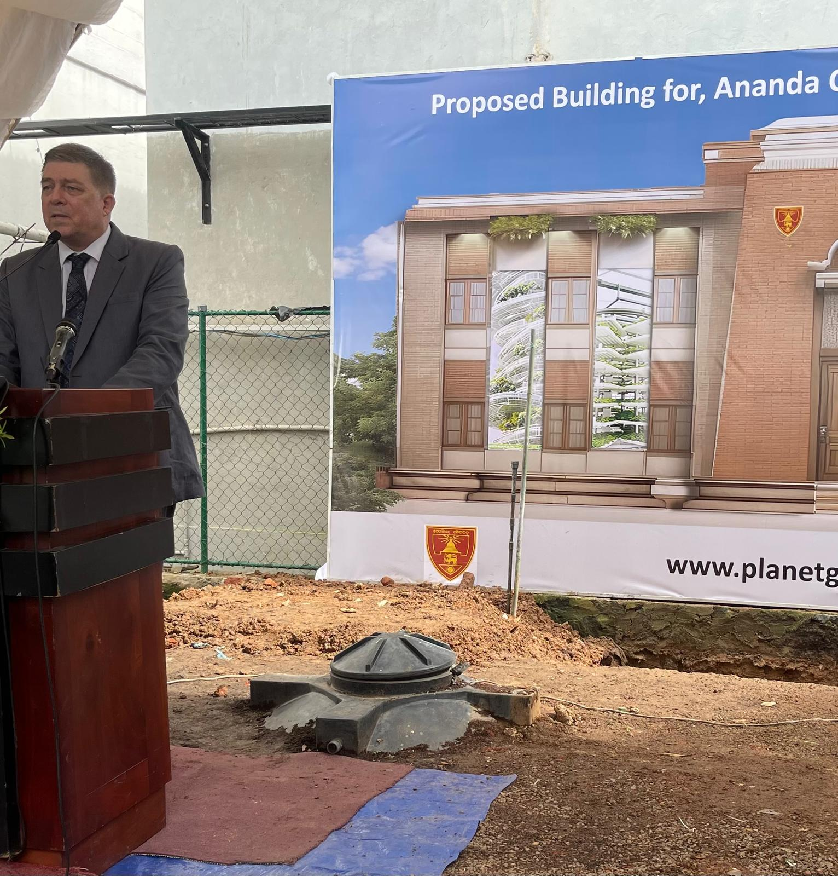
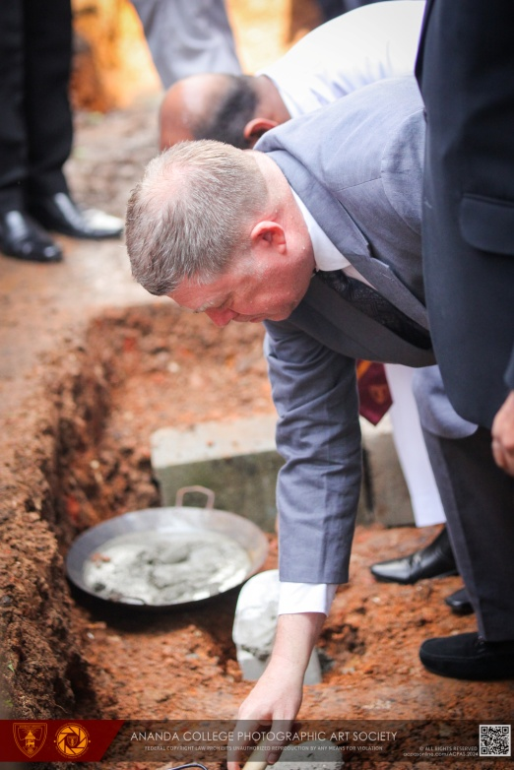
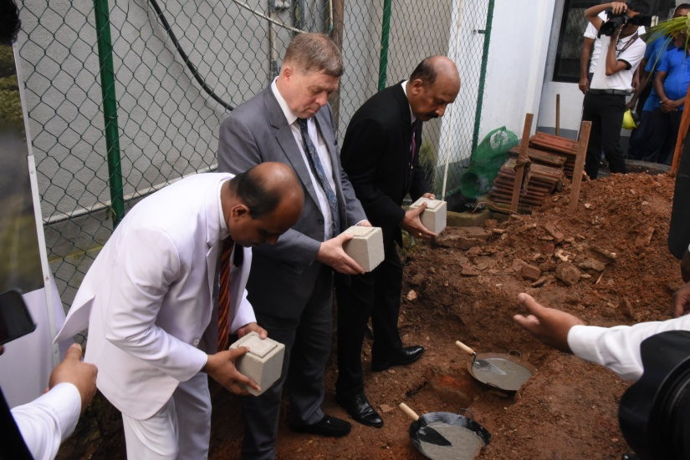
PGF Center Foundation Stone Laying

Slide 16


Slide 17
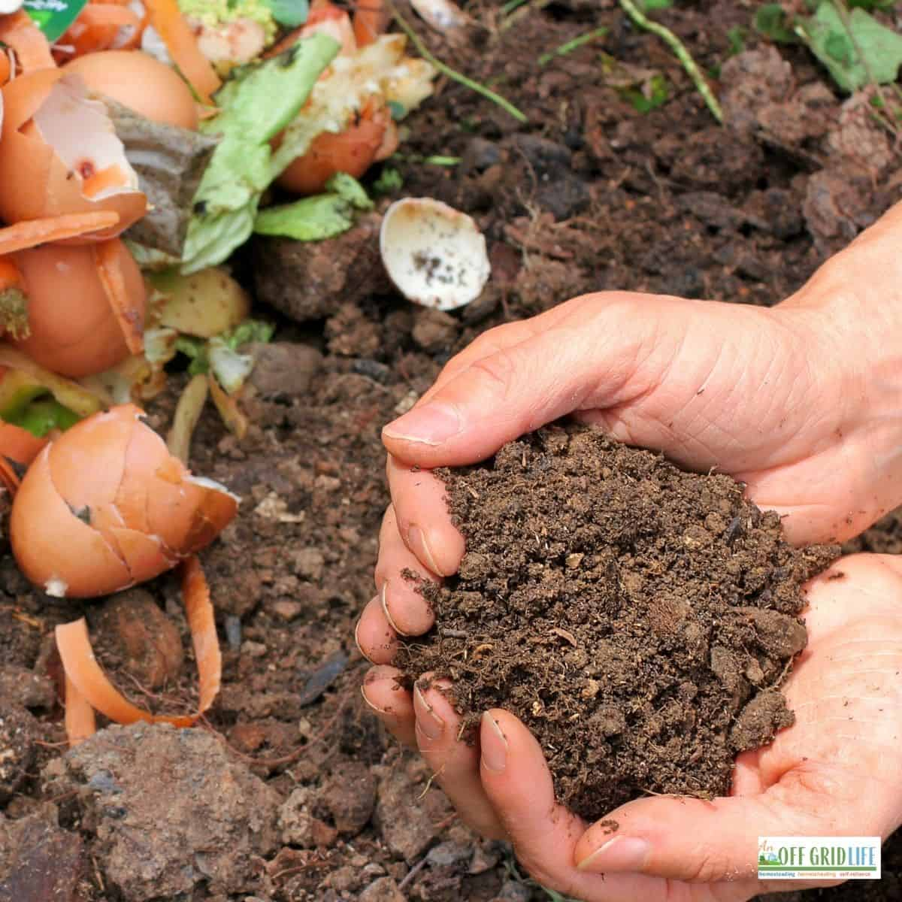
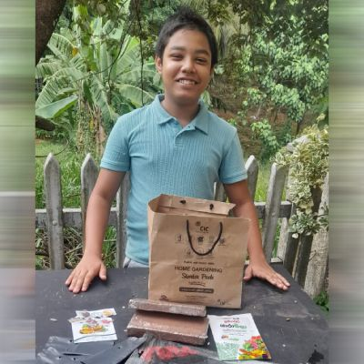
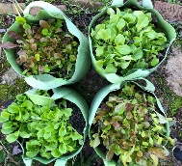
“Seeds of Security”
Grow
Grow container gardens at home: engage families
Provision
Provision of school hydroponics and/or aquaponics, work in school gardens
Start
Intro to composting; start school compost pile/container
Develop
Develop nutritious menu items from crops
Sell
Sell excess through school marketplaces; help make program self-sufficient
Create
Create opportunity similar to UN Food & Agriculture Organization’s “Global Chef Challenge” / Create cookbook
Field
Field trips to farms, green markets, etc.

Slide 18
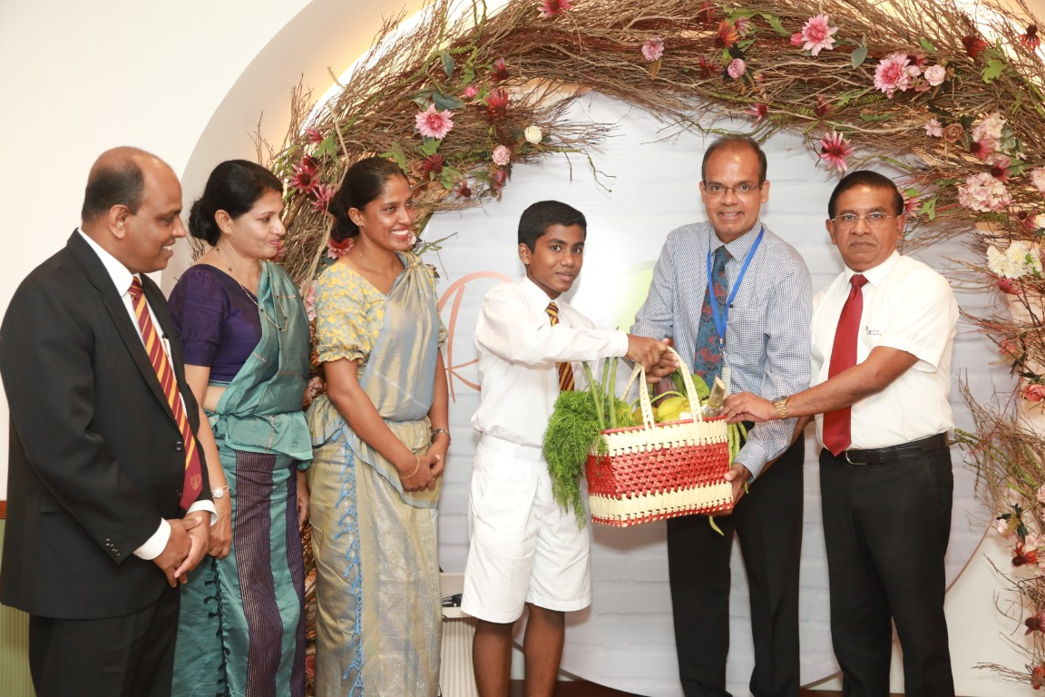
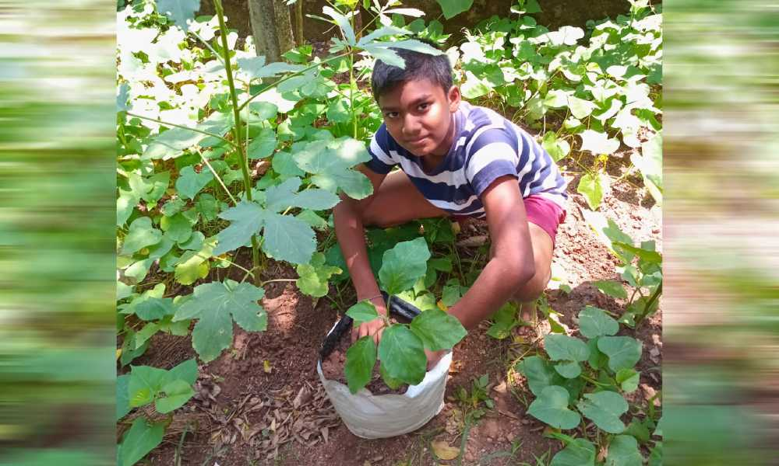
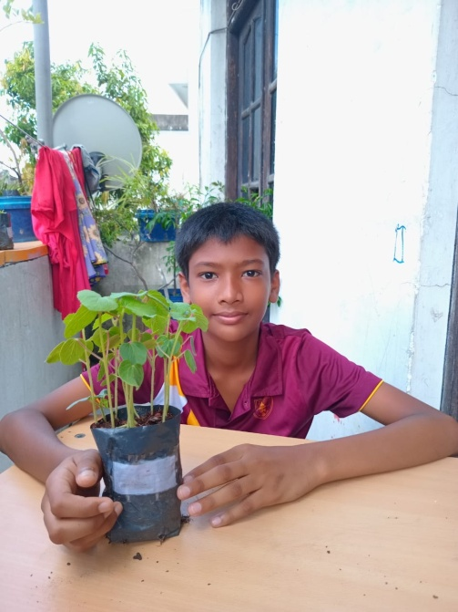
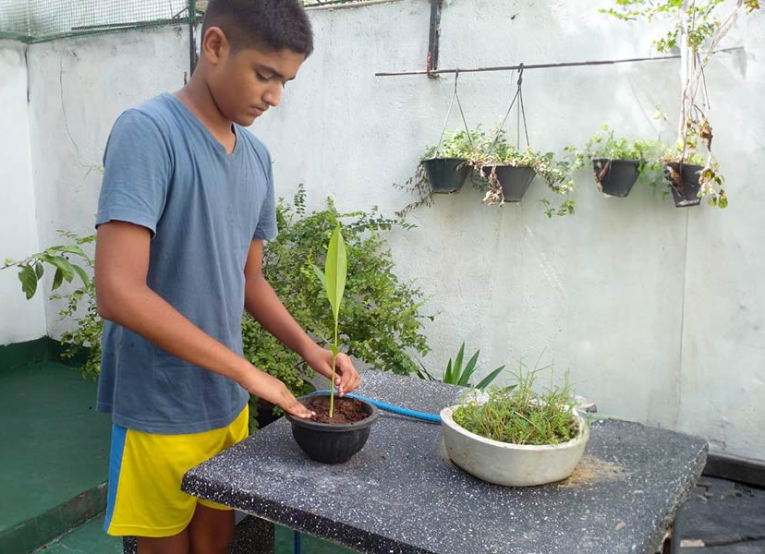
CIC Partnership
Sowing the Seeds of Security

Slide 19
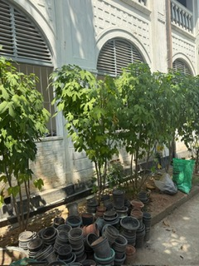
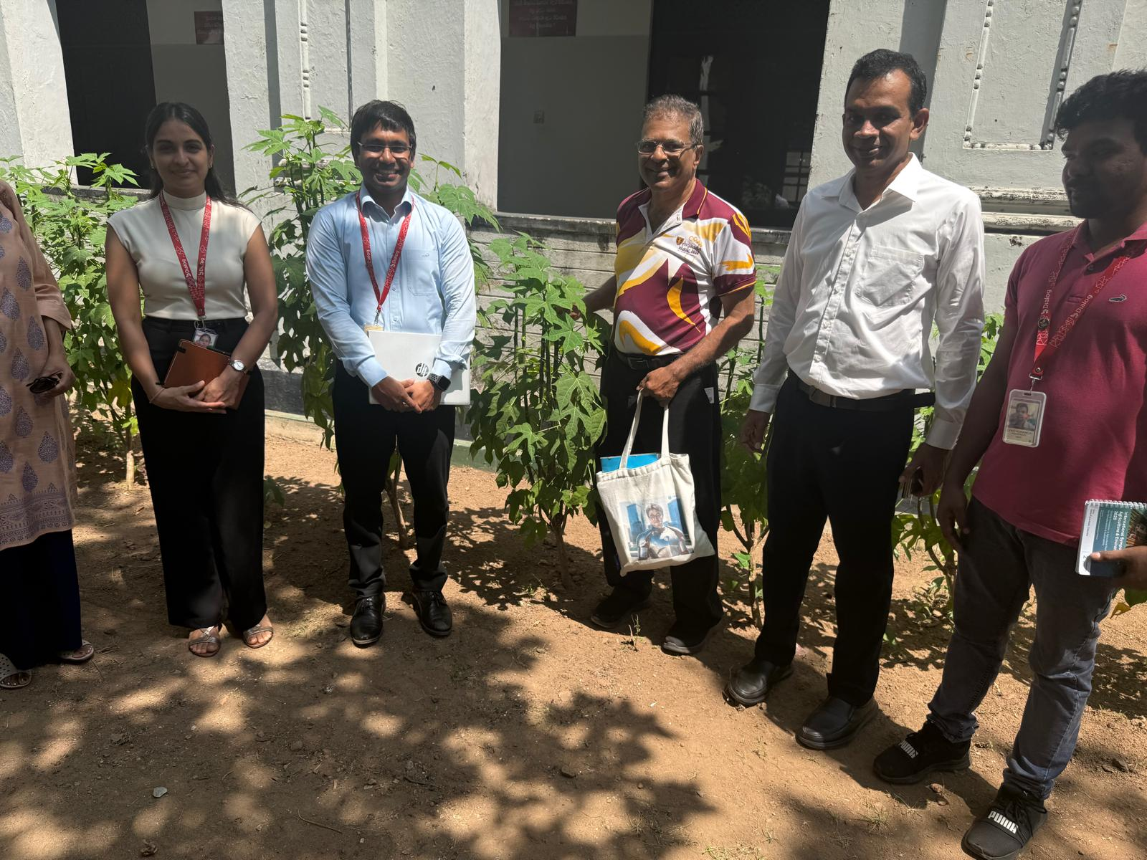
Dialogue with ‘Dialog’

Slide 20
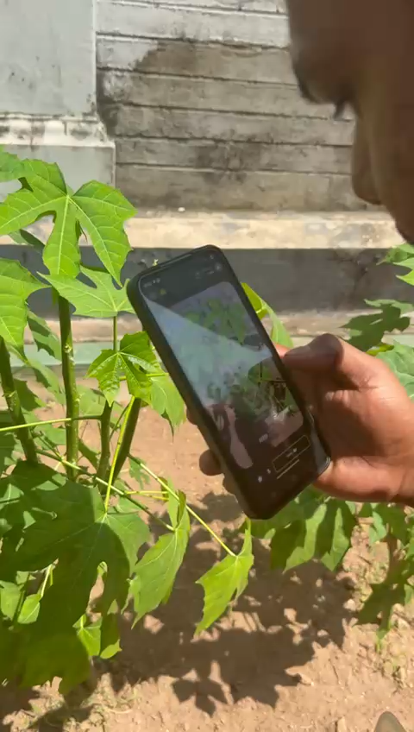

Slide 21
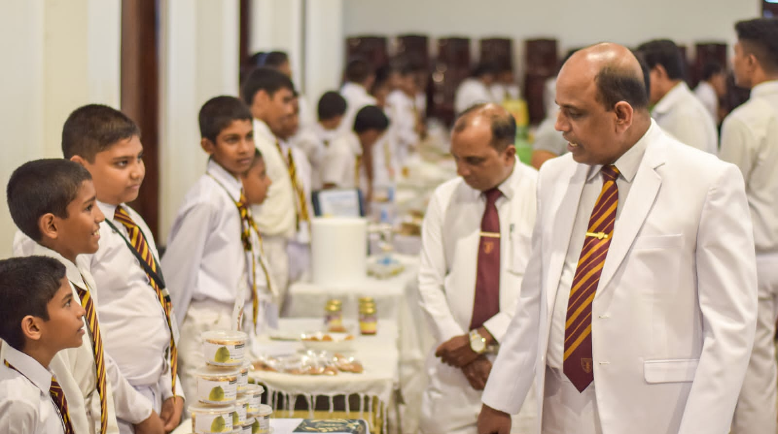
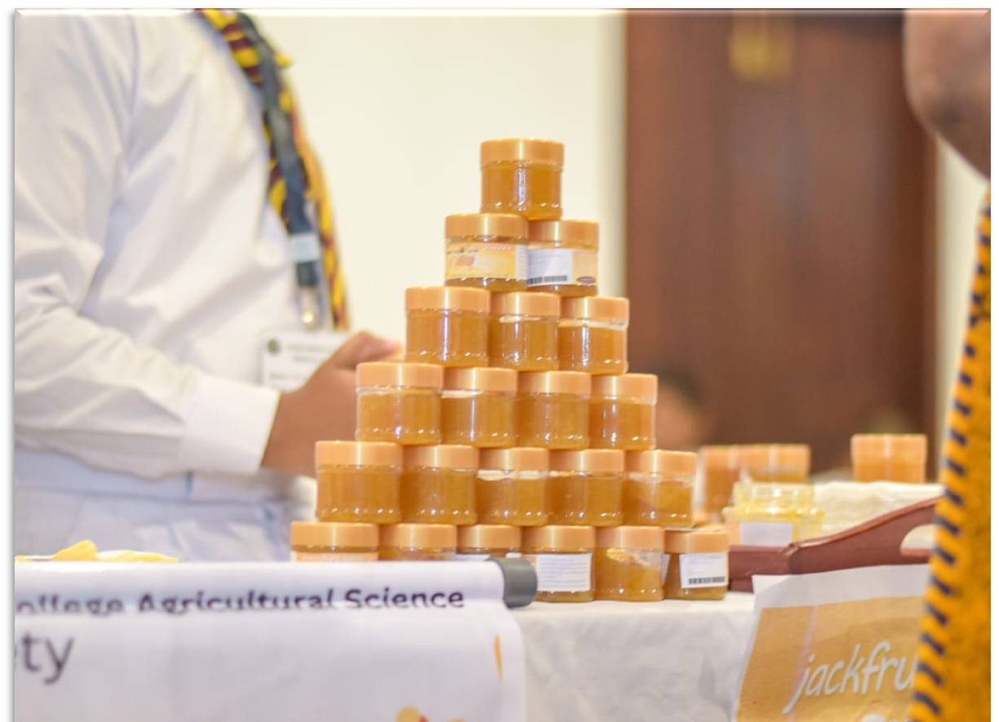
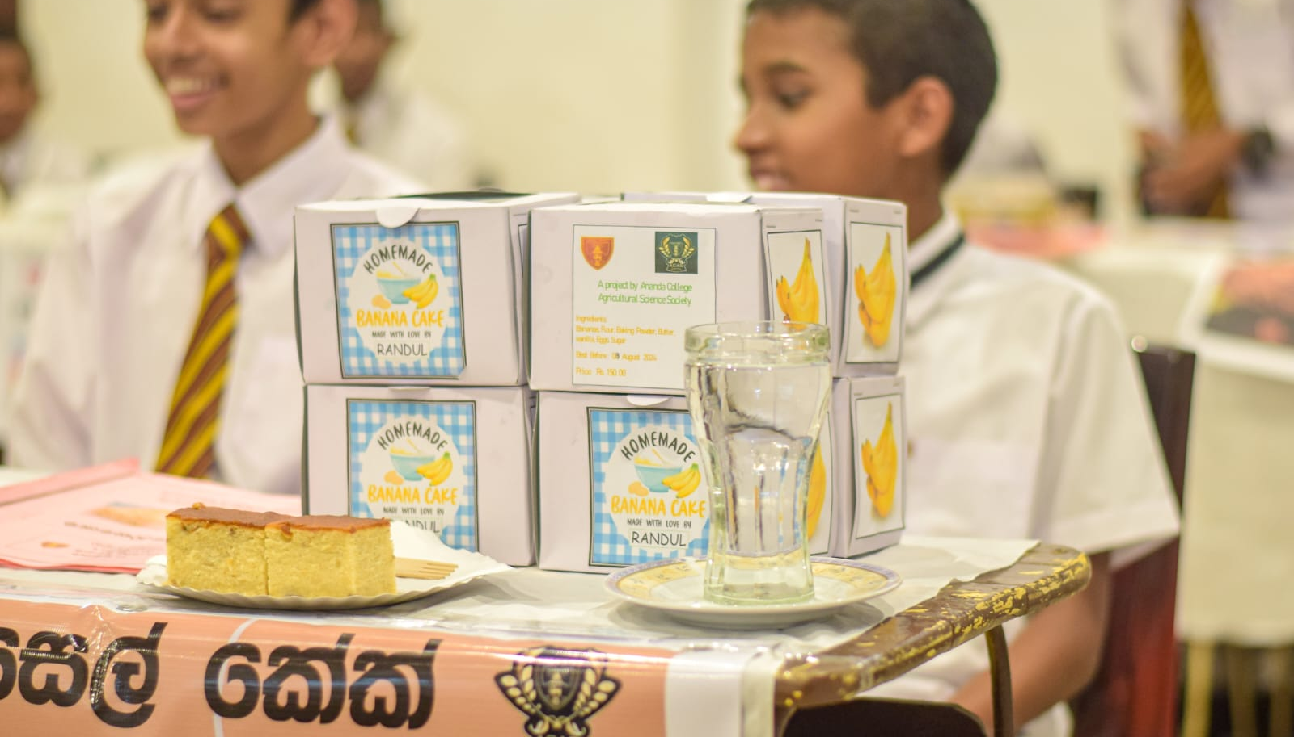
Nutritious & DELICIOUS Creations

Slide 22
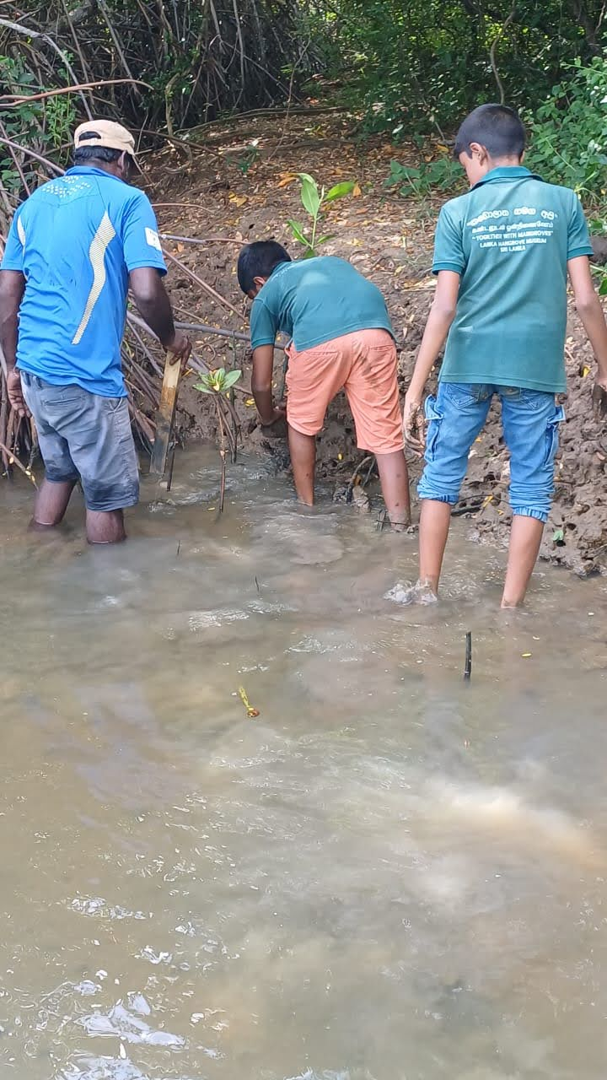
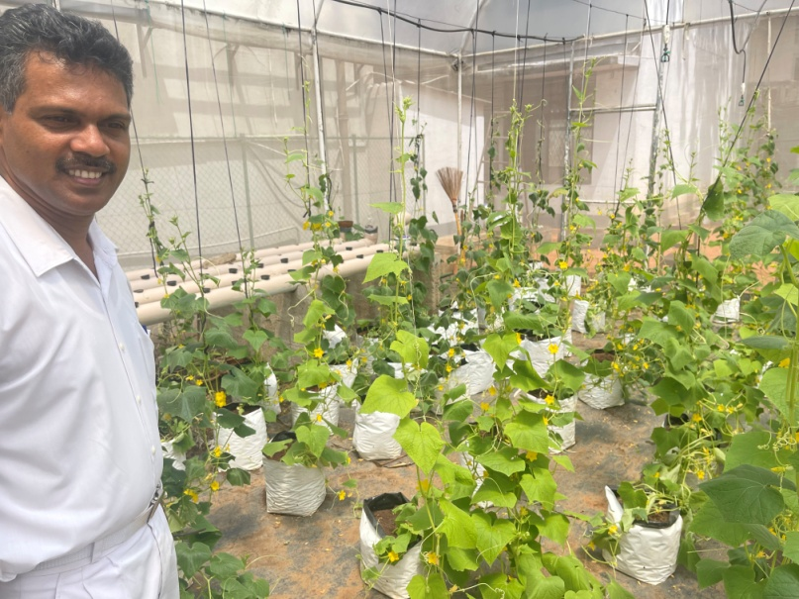
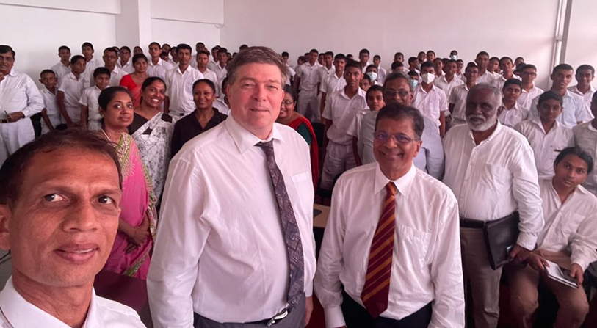
Ananda PGF Master Plan
Theory into Practice
Activity 1: Seeds of Security
Activity 2: Green Challenges
Activity 3: Green Educators
Activity 4: Green Academies Research Hub
Activity 5: Green Explorers
Activity 6: Eco Advocacy
Activity 7: Eco Voice
Activity 8: Green Melodies

Slide 23
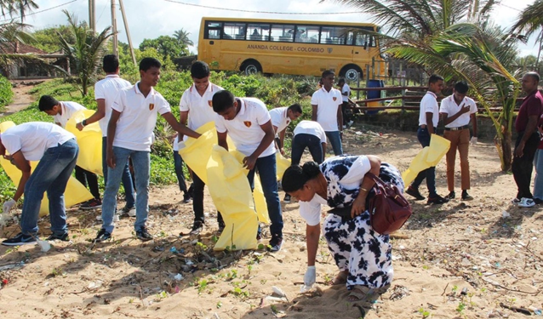

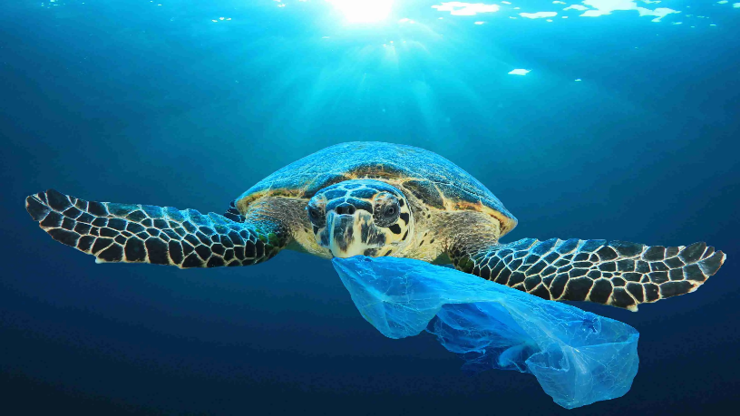
PGF Sustainable Ideas Competition
October 2025
Seek innovative sustainable solutions from Ananda students; plans to expand to other Sri Lakan schools in future
Creativity encouraged! Family input/engagement welcomed
Students responded to grade-level prompts or submitted original idea
Top submissions recognized, will receive award & chance to help bring ideas to life
5,000+ entries

Slide 24
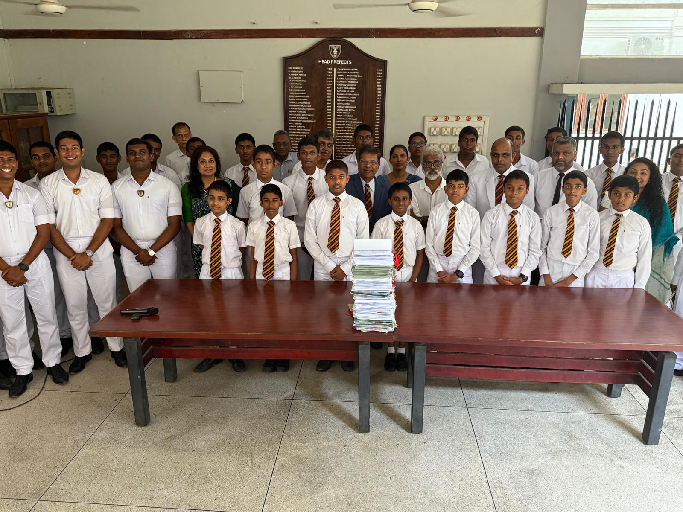
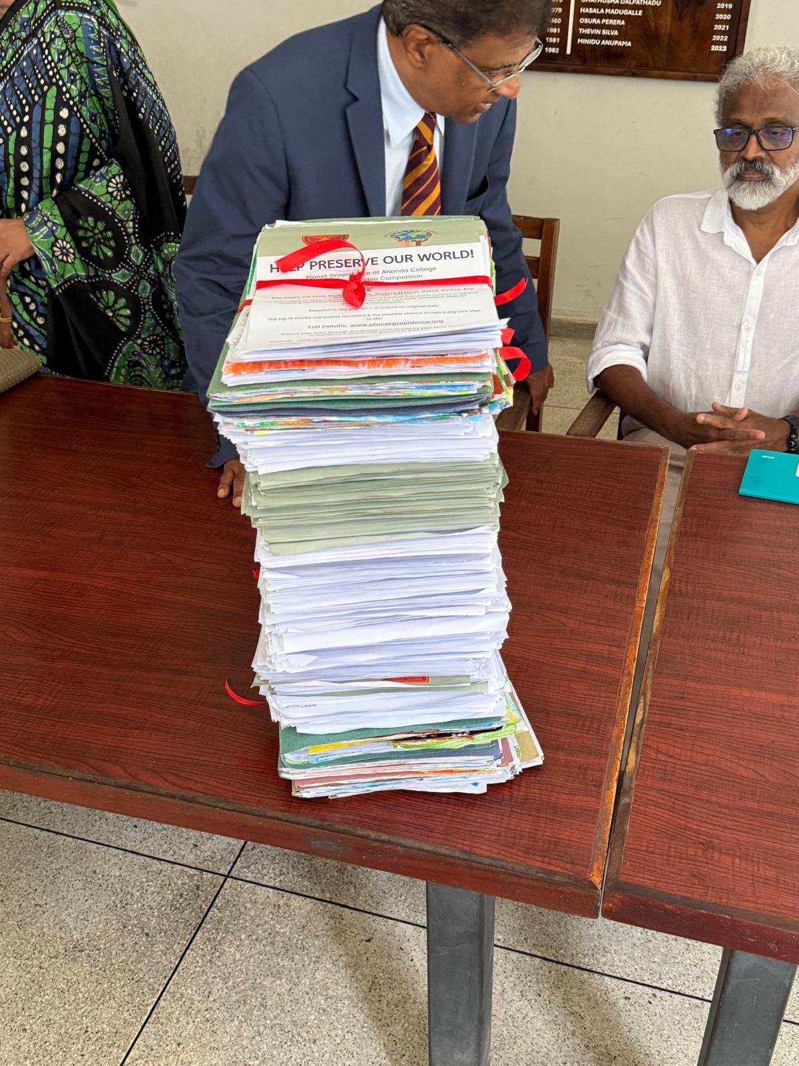
Climate Change 5,000 Ideas.

Slide 25
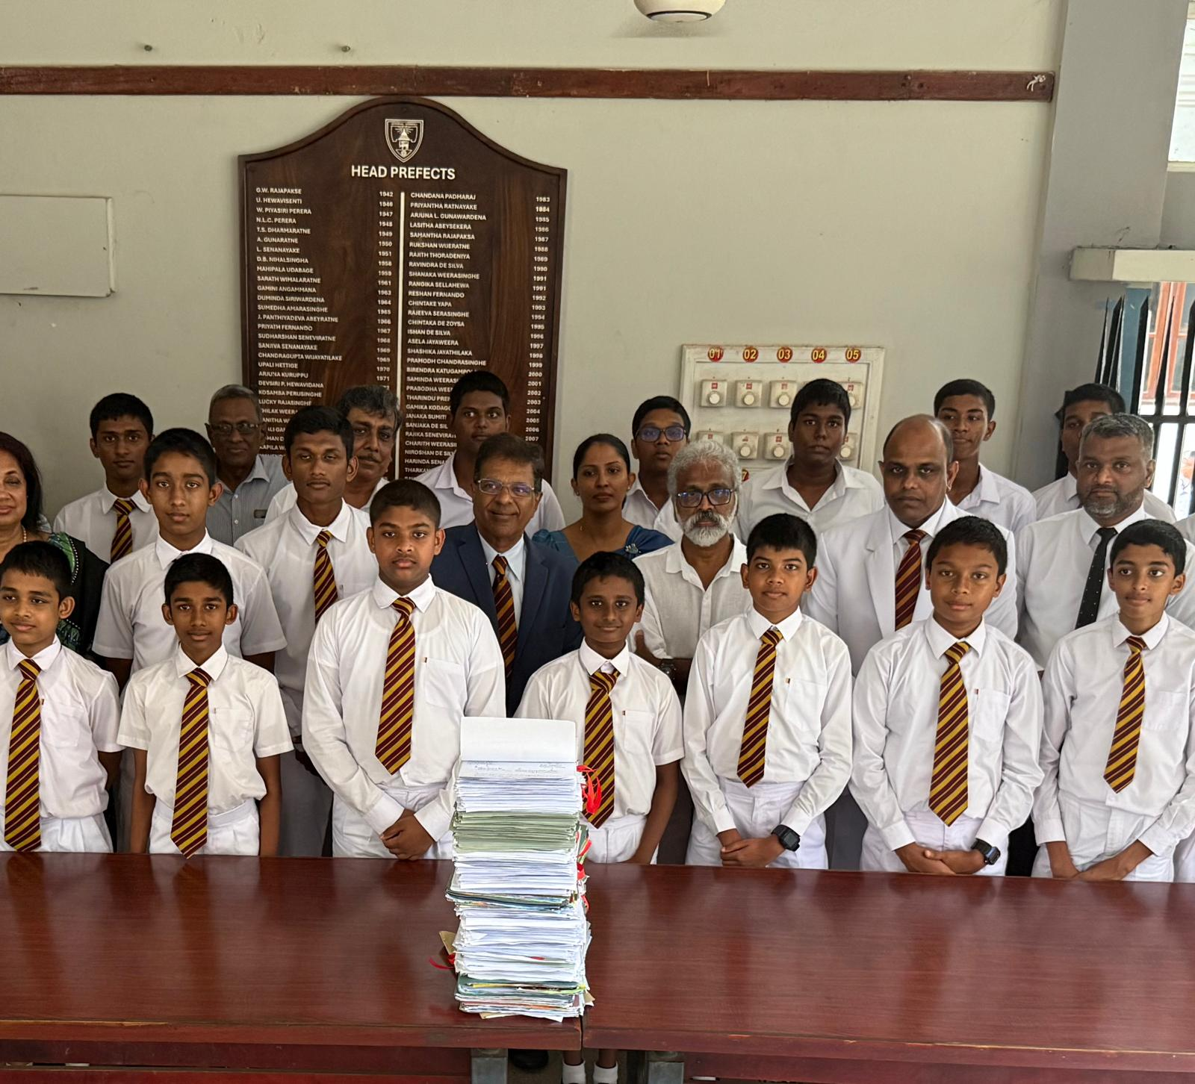

Slide 26
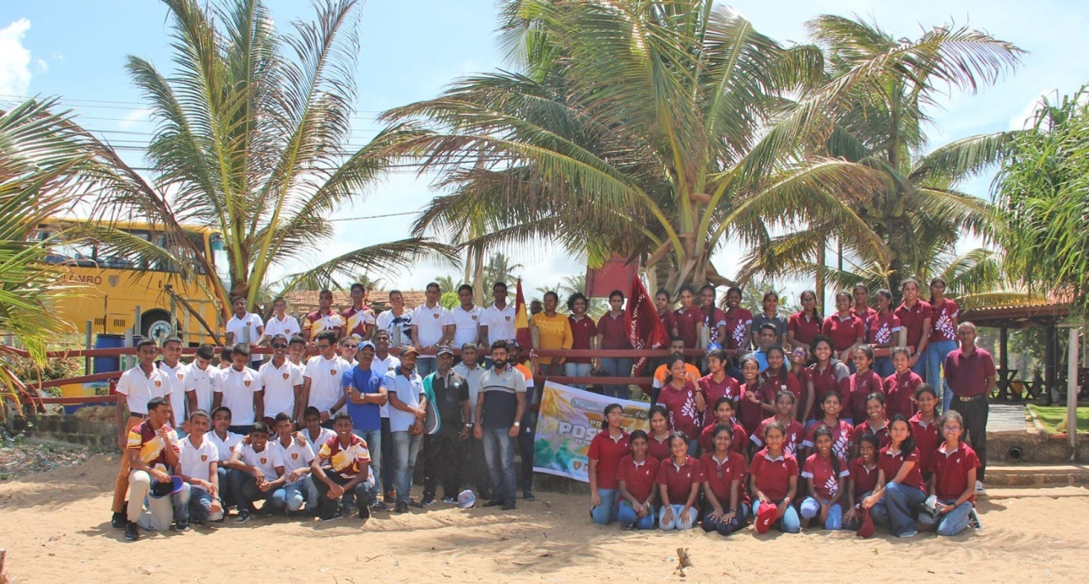
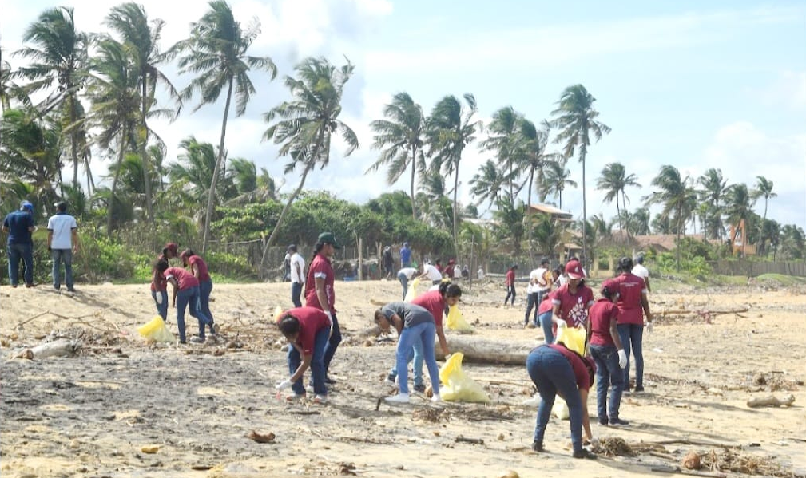
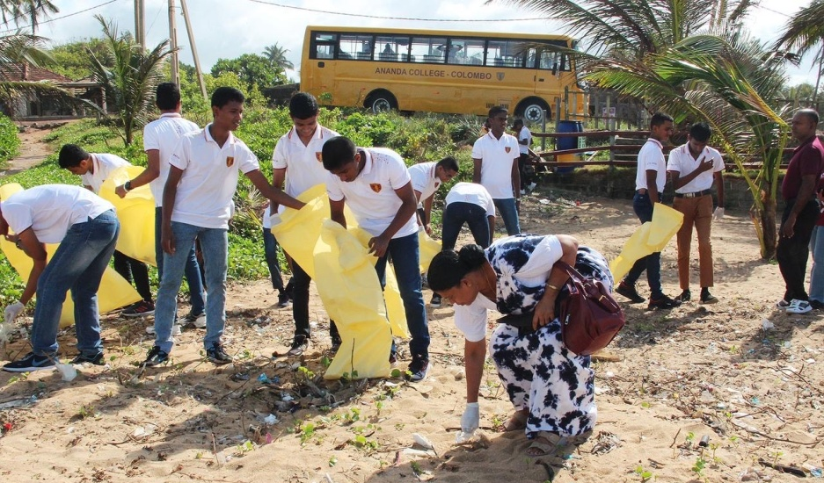
Working Collaboratively Toward
A Cleaner World

Slide 27
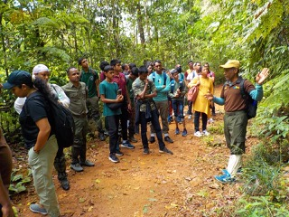
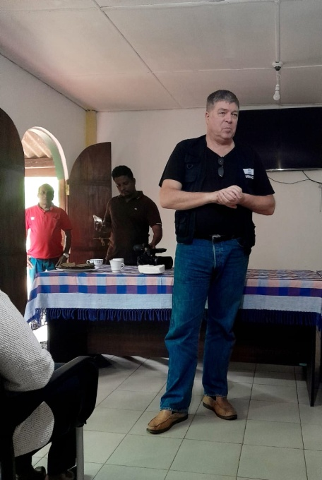
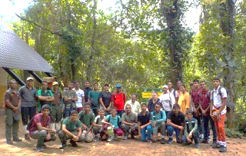

Field Trip to Sinharaja Rainforest

Slide 28




International Day of GREENING Education
& Chaya Presentation
With UNESCO ASPNet Schools

Slide 29





PGF Art Exhibit at Ananda College
Advocacy through Art

Slide 30




Progress on Ananda’s Planet Green Force Center

Slide 31




Areas allocated for UN interactive learning and research installations, international best practices and to promote SDGs

Slide 32


Incorporating the 17 SDGs- Staircase with 17 steps - representing the 17 SDGs

Slide 33





Slide 34


Planet Green Force
“In our hands now lies not only our own future, but that of all other living creatures with whom we share the Earth.”
– David Attenborough
Thank You for Your Time
www.planetgreenforce.org

